Slide 1
NEON Biorepository Data Skills Workshop
Kelsey Yule
Biodiversity Knowledge Integration Center
School of Life Sciences
Arizona State University
6 August 2024

Slide 2
Overview
The NEON Biorepository: Samples & Data
The NEON Biorepository Portal: Finding and downloading sample data
The NEON Data Portal: Finding and downloading contextual data
Combining & Analyzing multiple NEON data source

Slide 3
The NEON Biorepository

Slide 4
The NEON Biorepository
https://www.youtube.com/watch?v=-gHqSPJOETQ

Slide 5
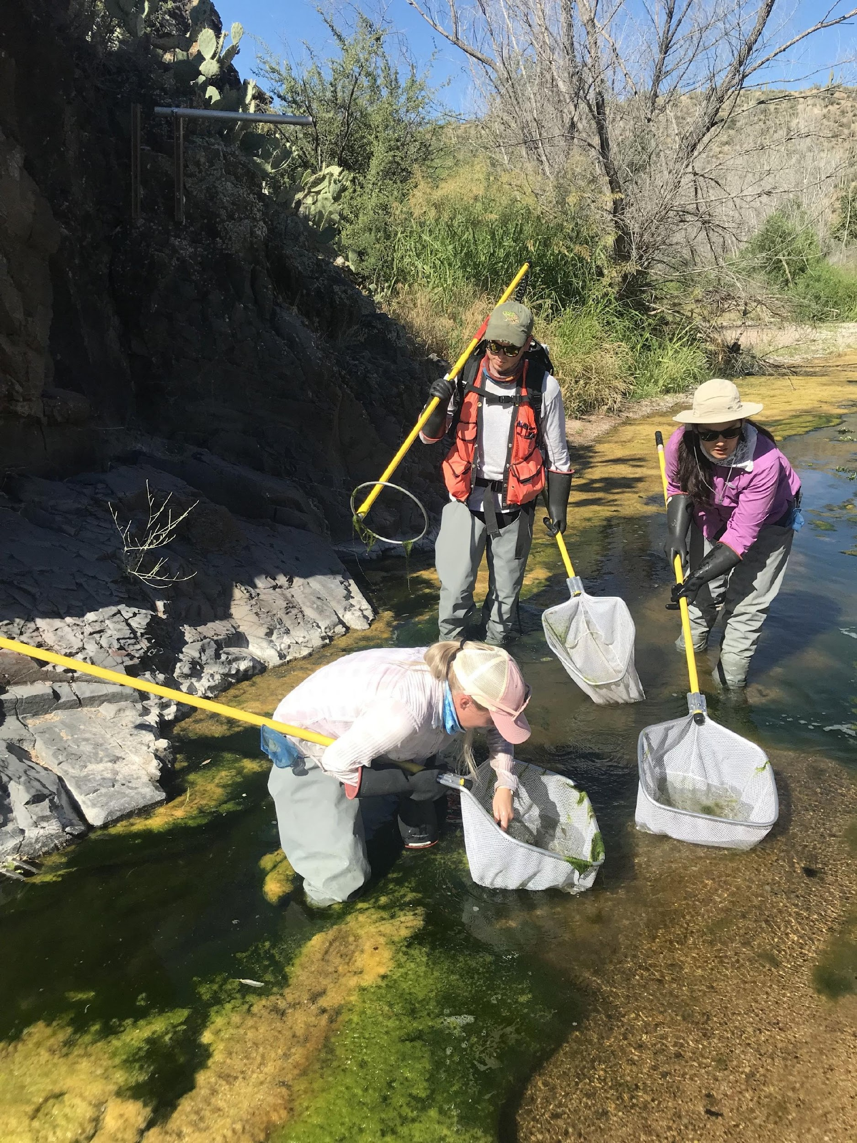
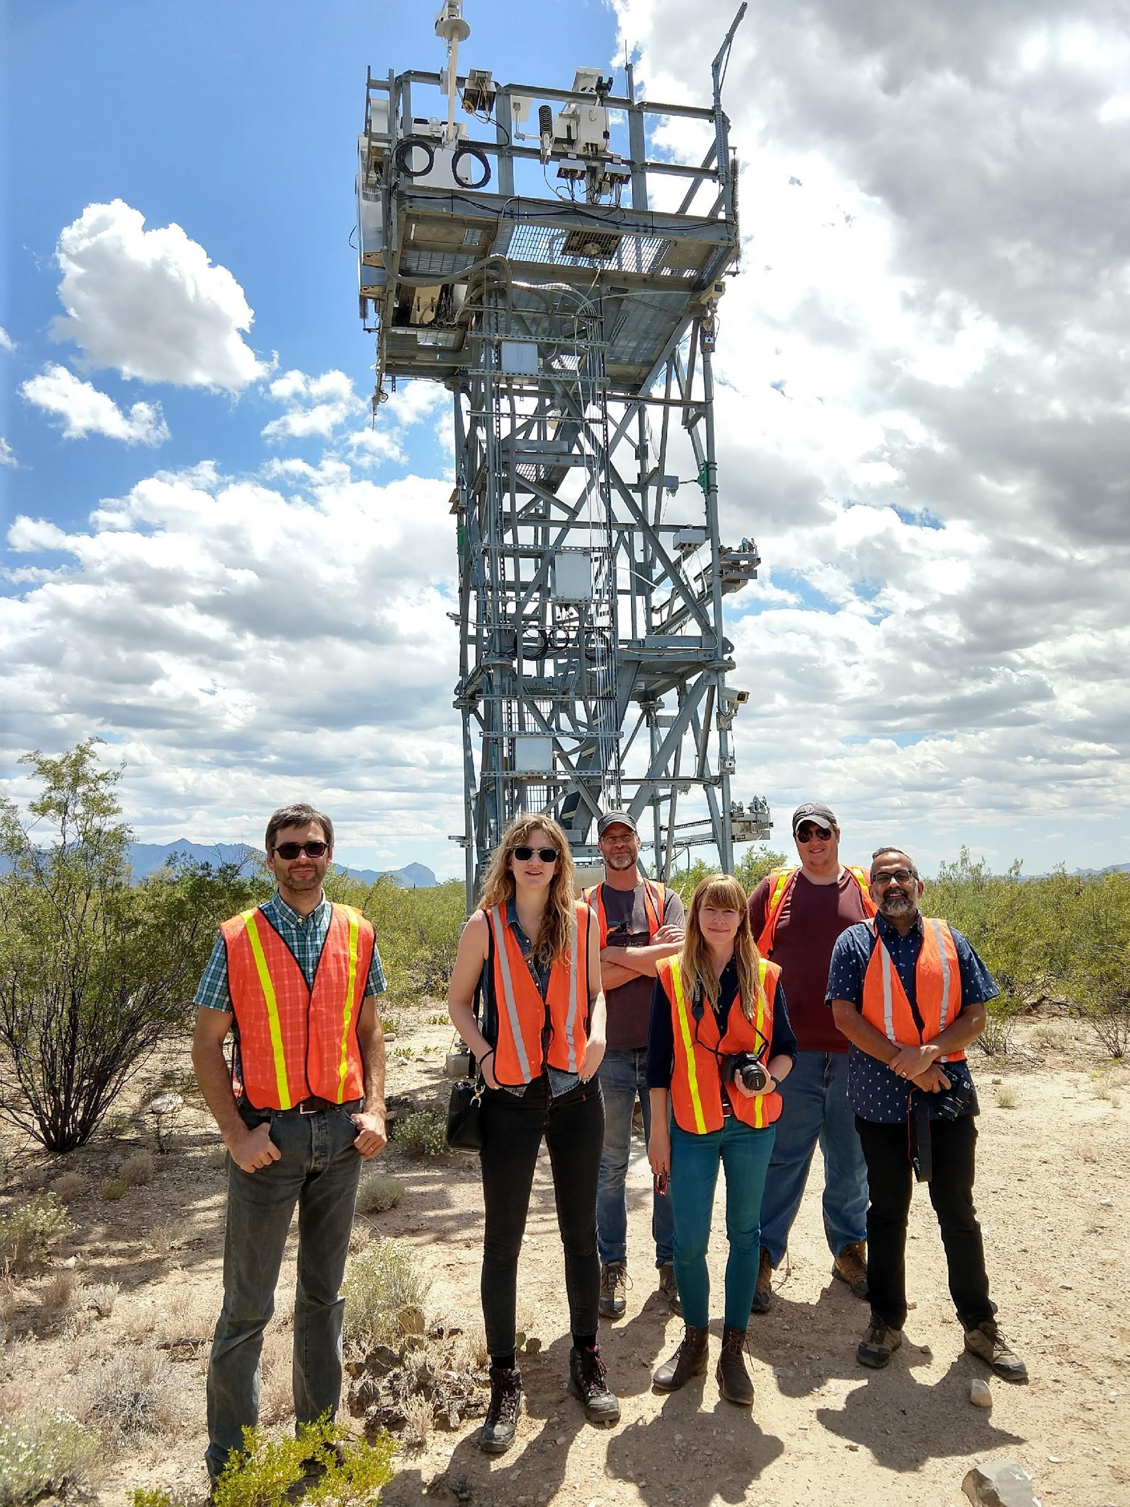
The National Ecological Observatory Network (NEON) is a continental scale program to monitor and forecast ecological change
Standardized organismal and environmental data collection
81 terrestrial and freshwater sites within 20 ecoclimatic domains across the US, including AK, HI, and PR
30 years of repeated sampling

Slide 6
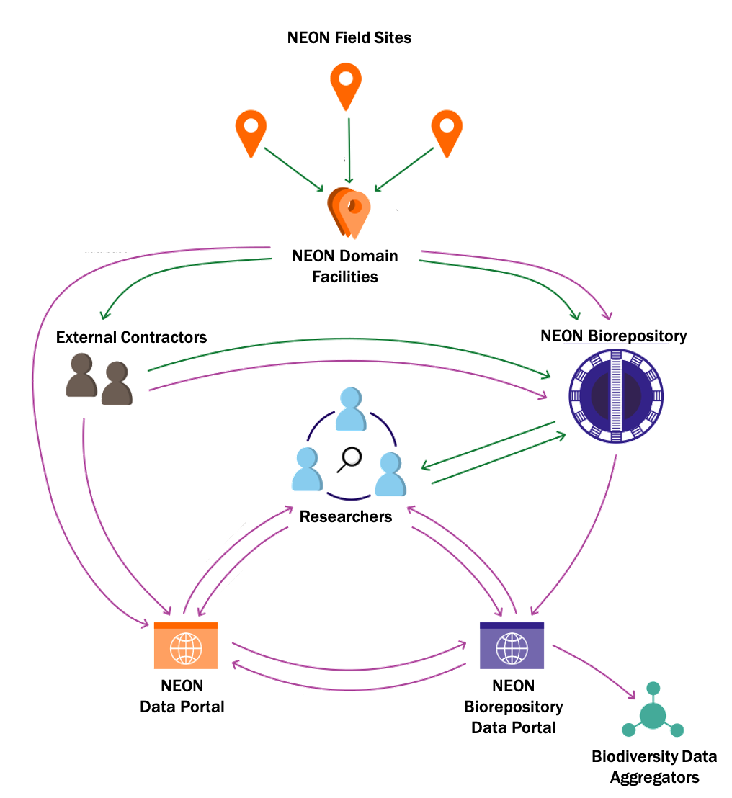
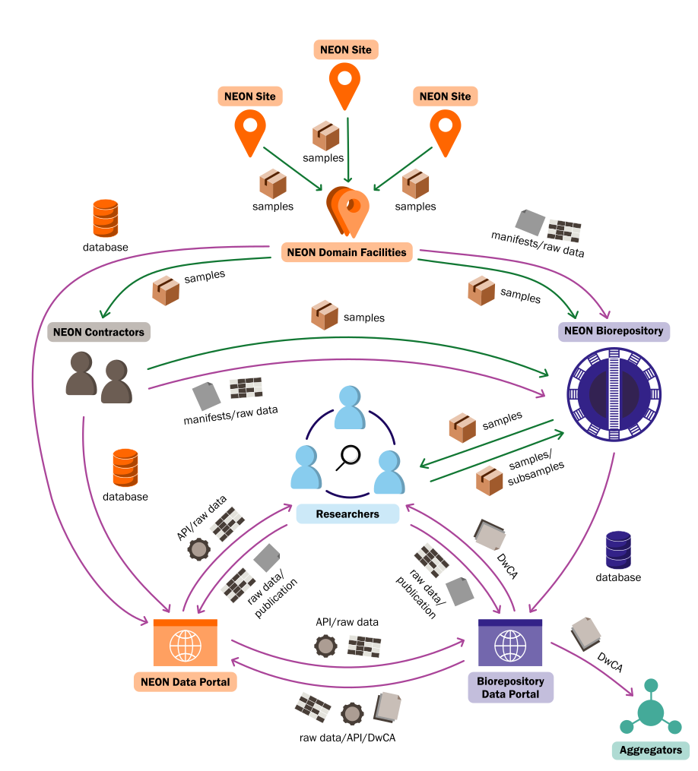

samples
The NEON Biorepository and its data portal are integral to the flow of NEON data and samples
data
biorepo@asu.edu

Slide 7
The NEON Biorepository is a turntable :
assimilate, redistribute, and reintegrate samples and data following FAIR principles
Findability
Accessibility
Interoperability
Reusability
samples
data
biorepo@asu.edu

Slide 8
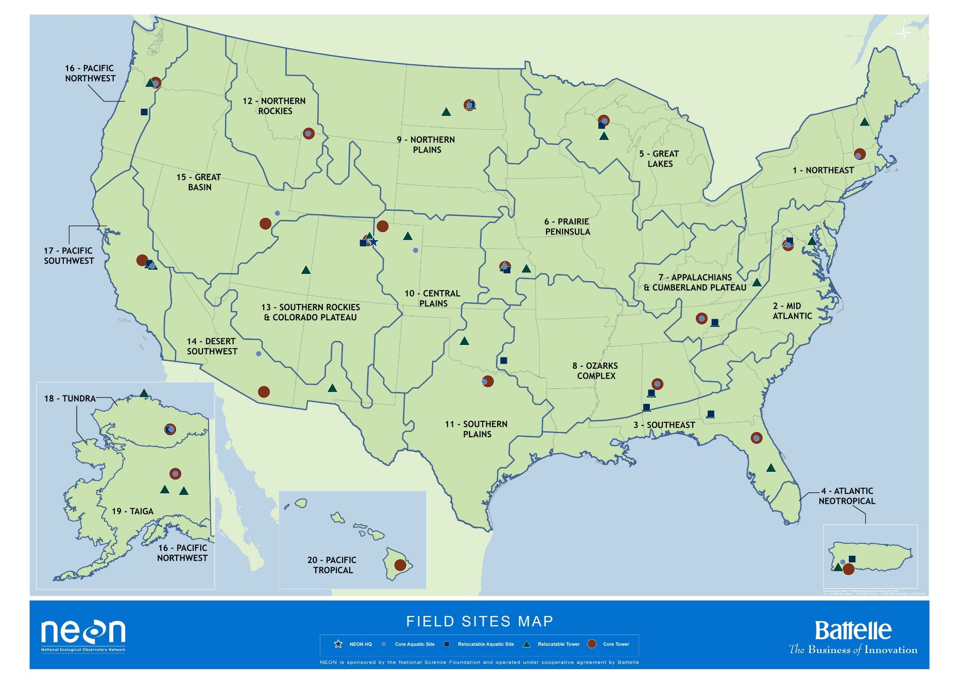

Physical samples are collected at all 81 NEON field sites
biorepo@asu.edu

Slide 9
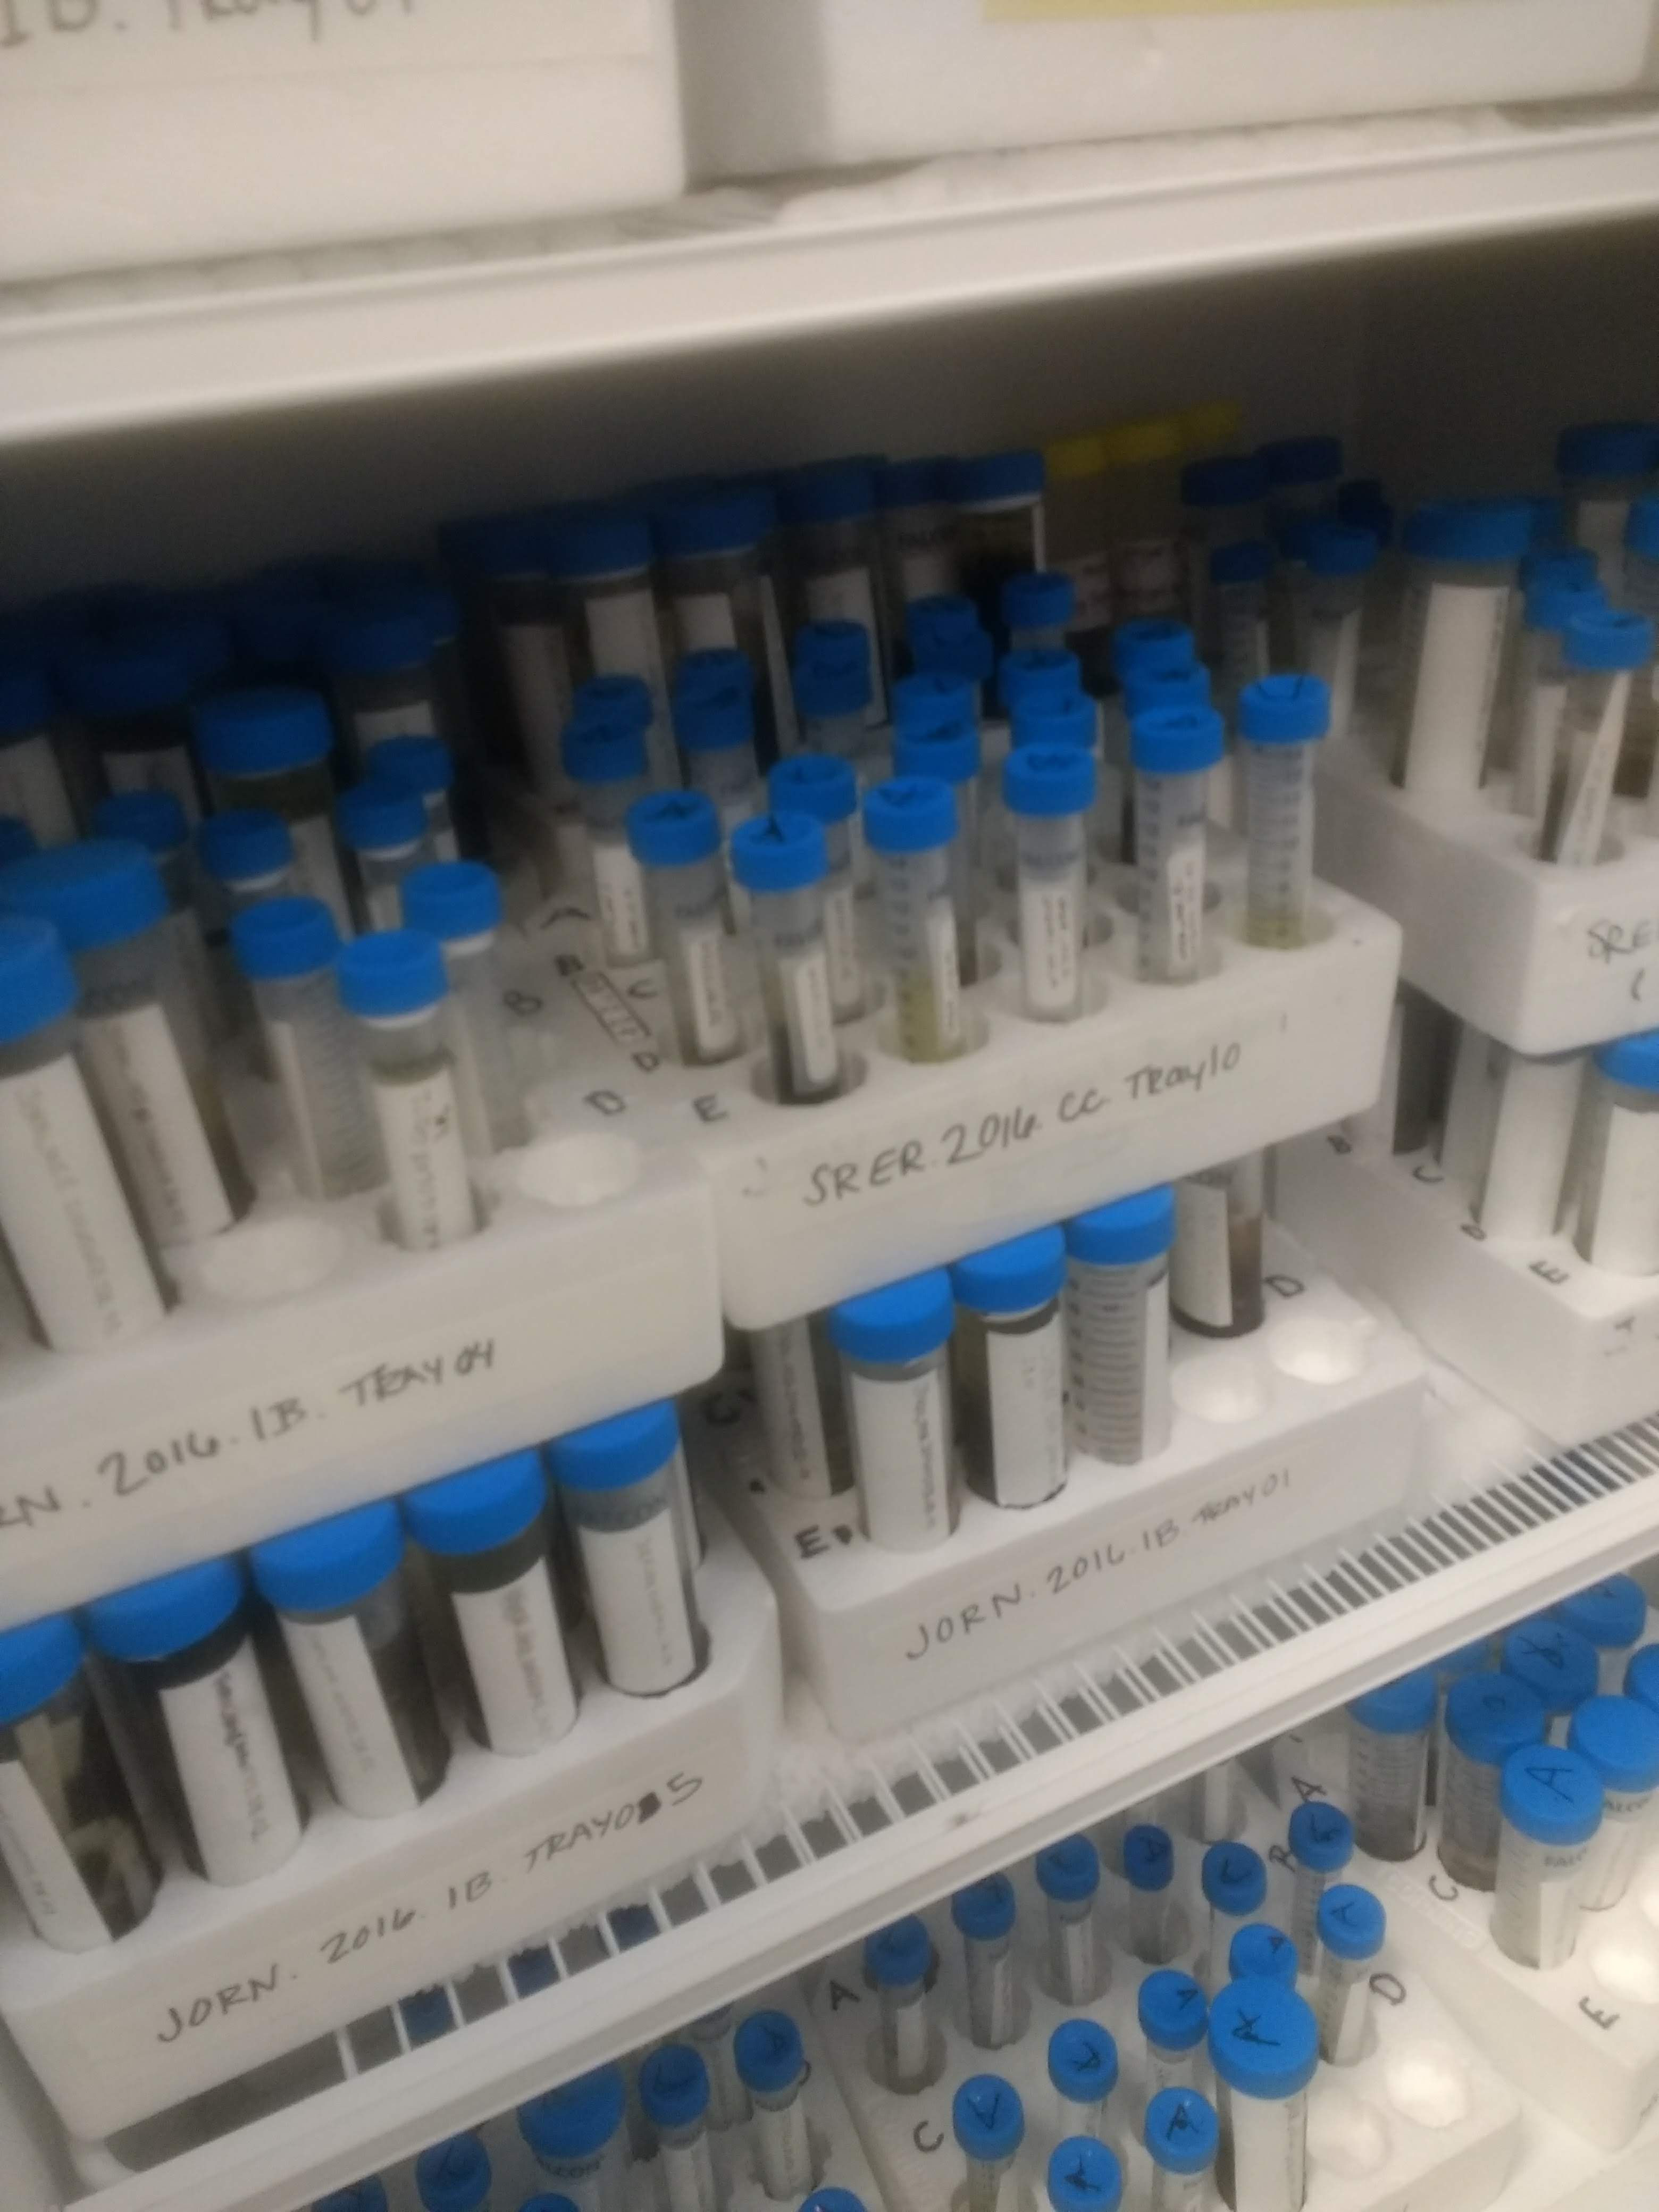
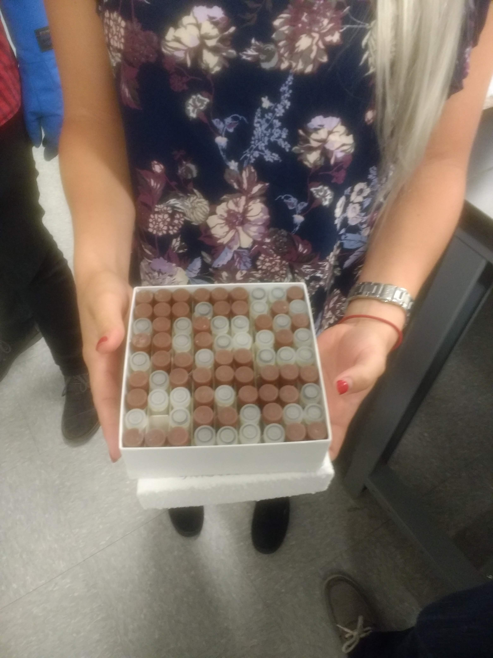
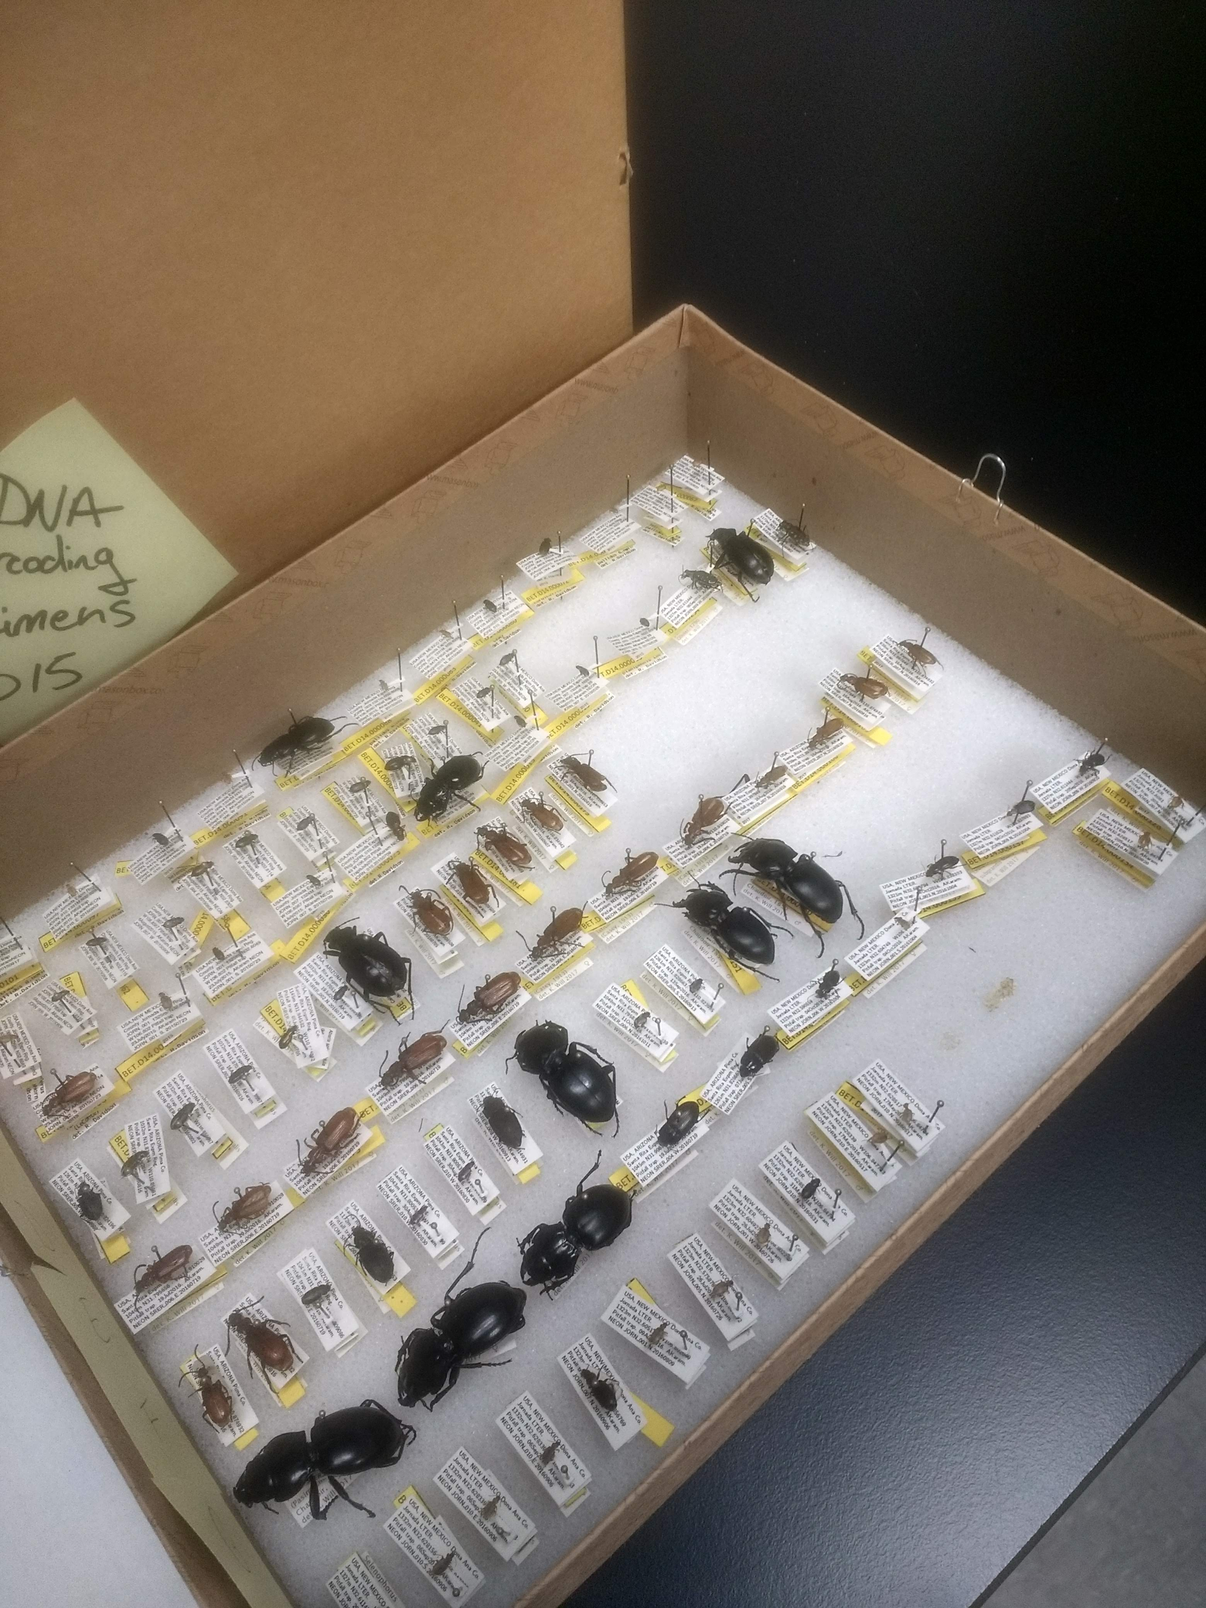
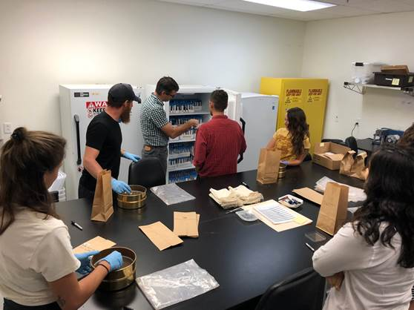
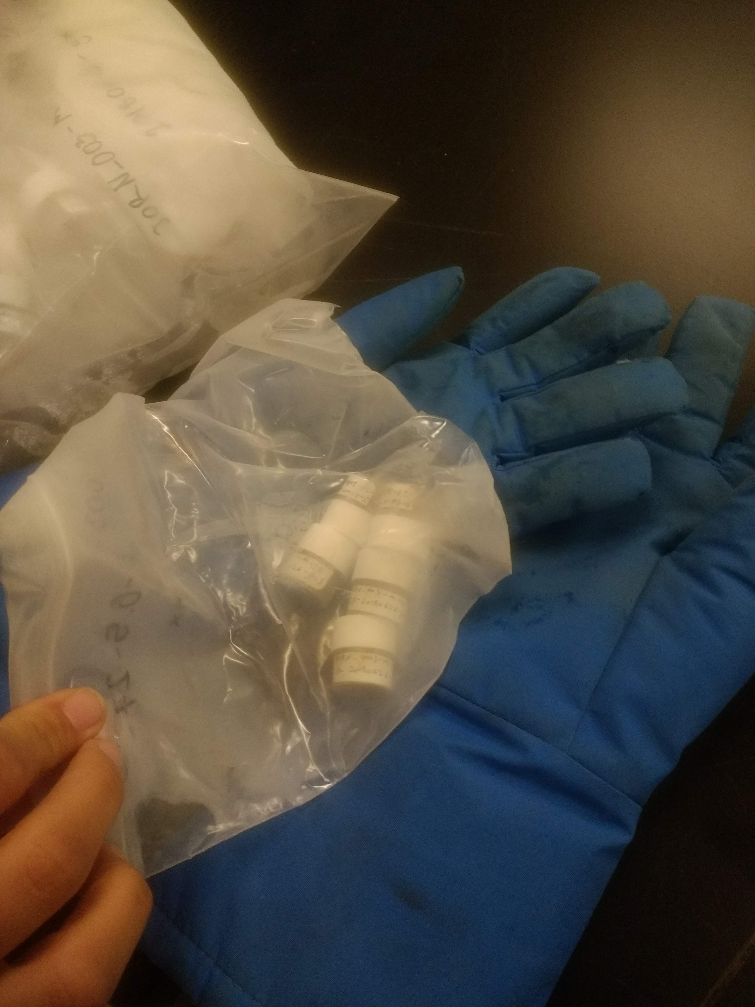
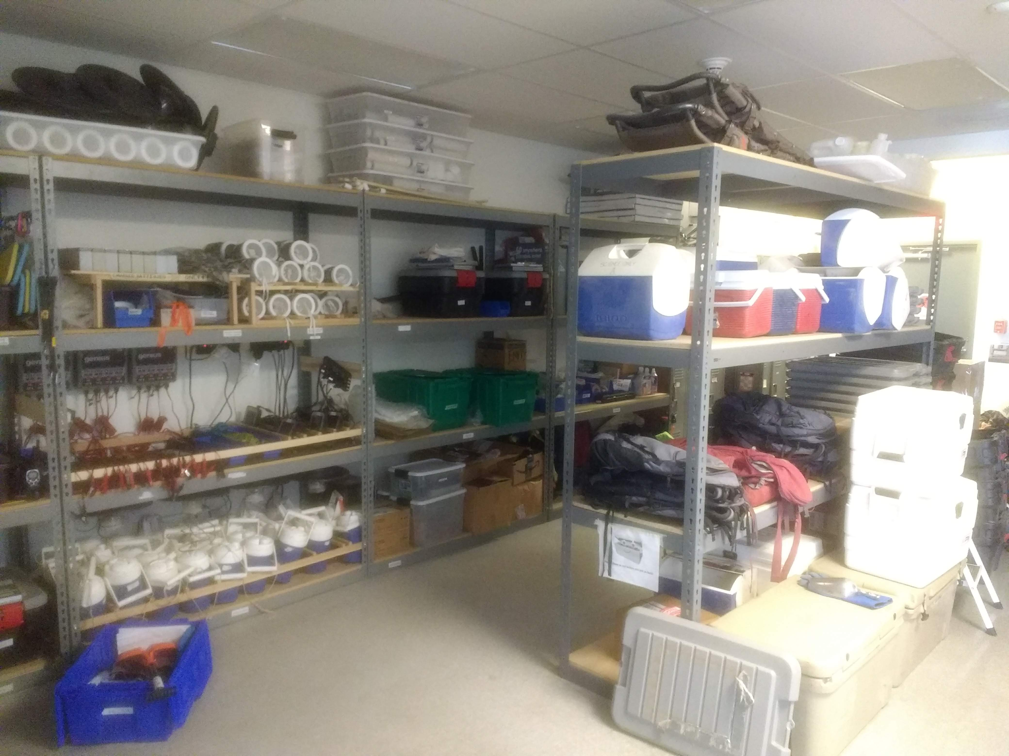
Samples are transferred to the 18 domain facilities
biorepo@asu.edu

Slide 10
Samples are transferred to the 18 domain facilities → Biorepository or external contractors
biorepo@asu.edu

Slide 11
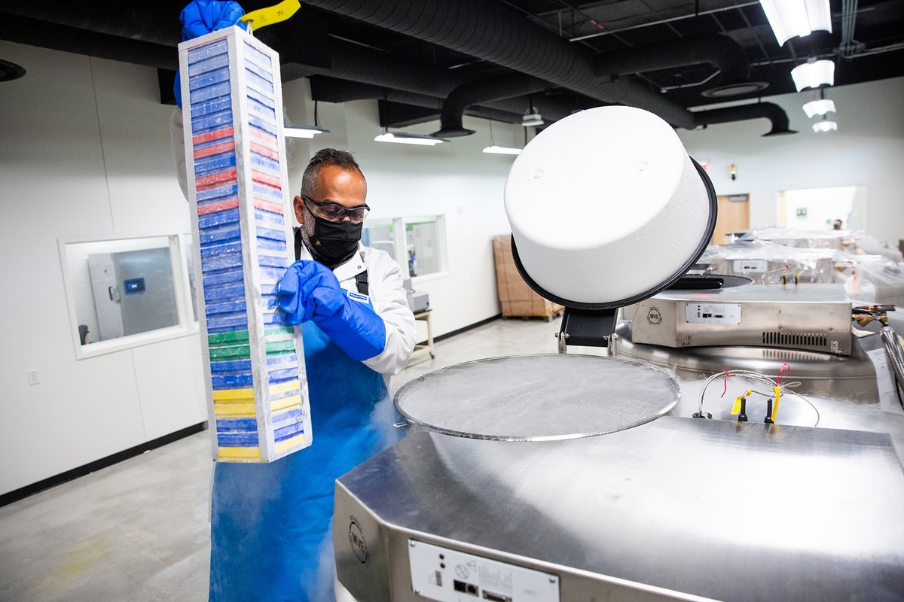
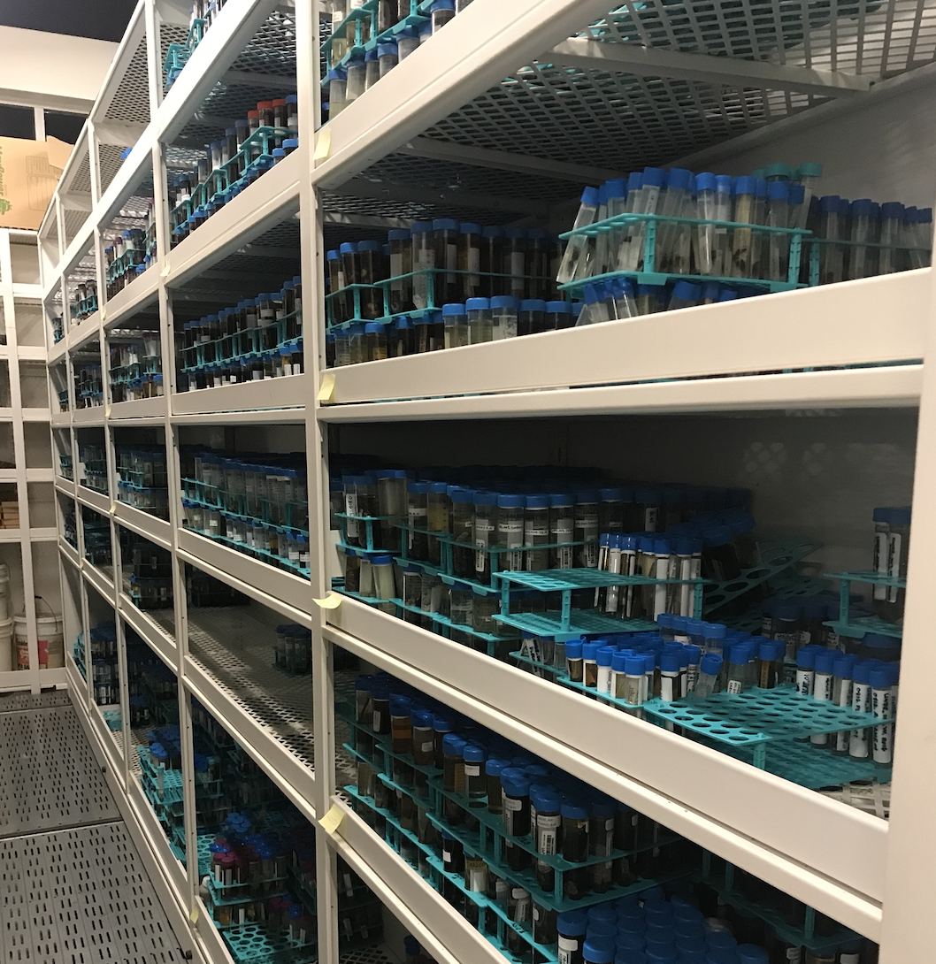
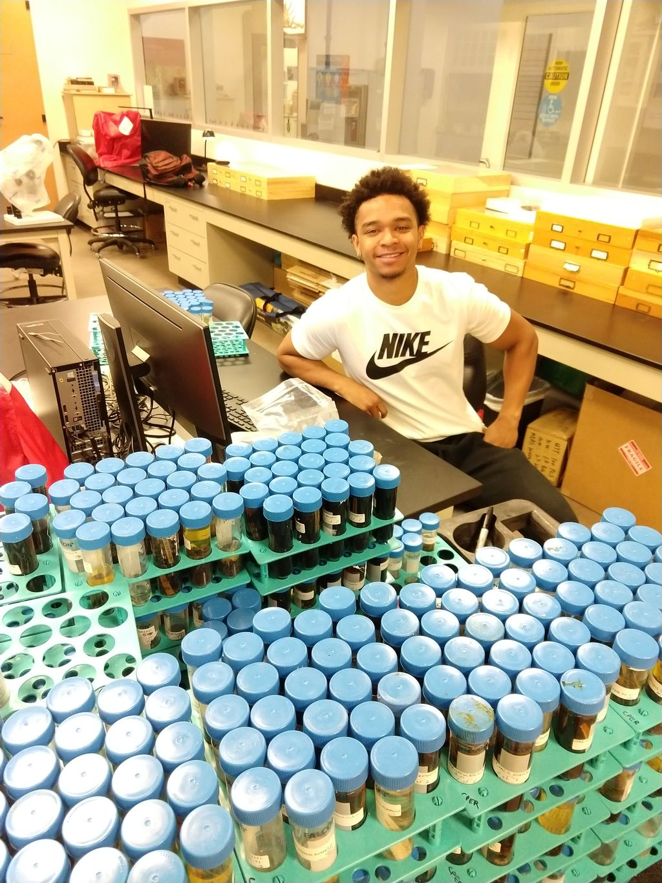
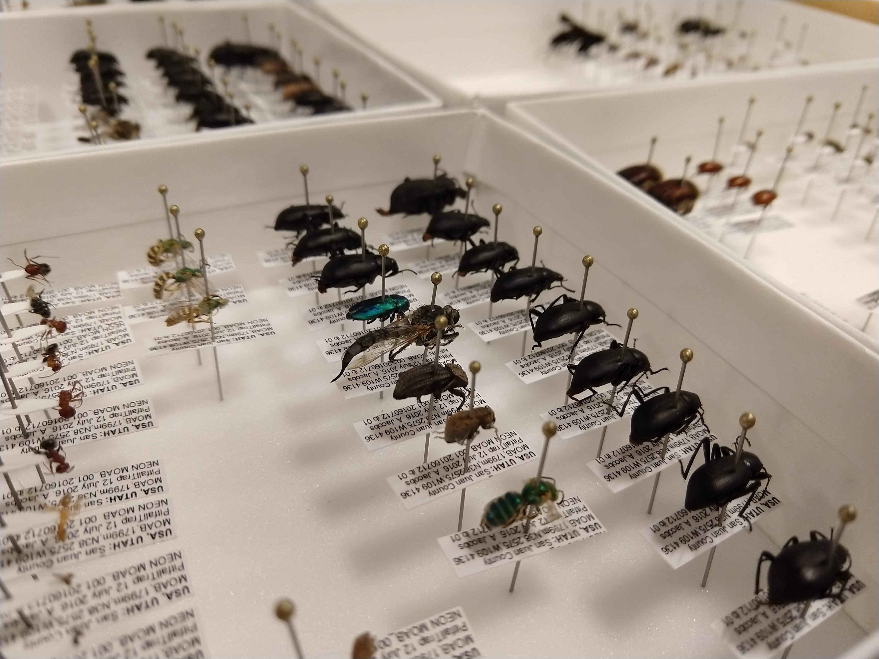
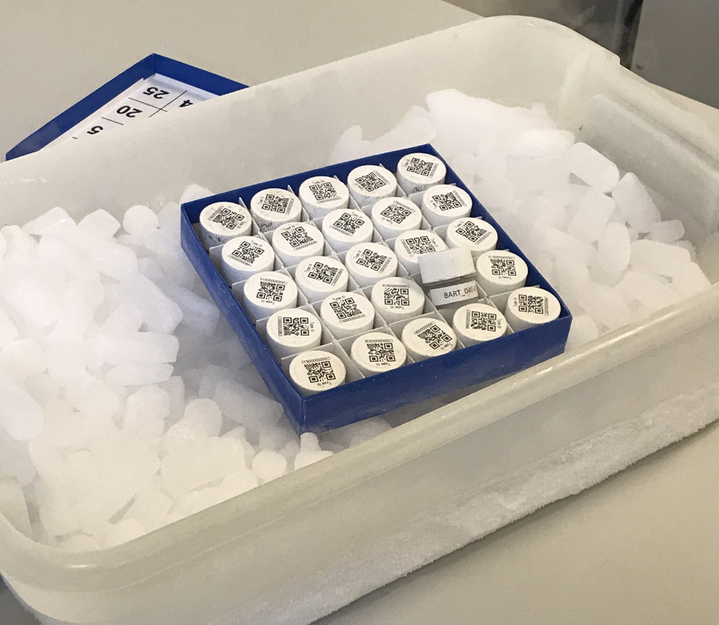
Samples are sent from external contractors and domain facilities to the NEON Biorepository where they are curated
biorepo@asu.edu

Slide 12
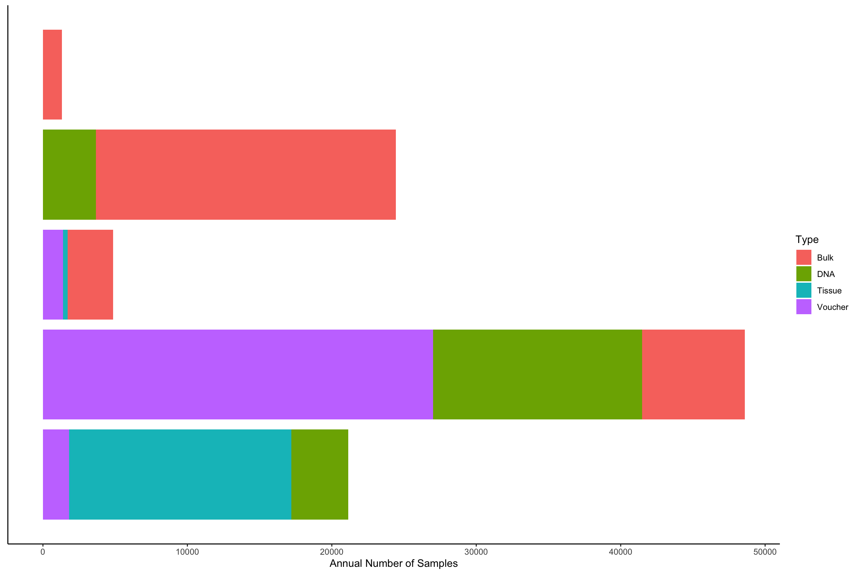
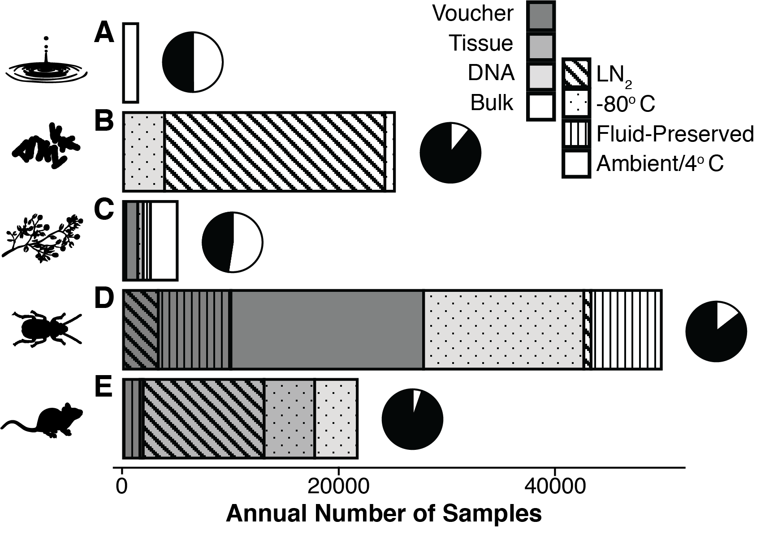
Annual sample intake
environmental
microbial
plant & algal
invertebrate
vertebrate

Slide 13
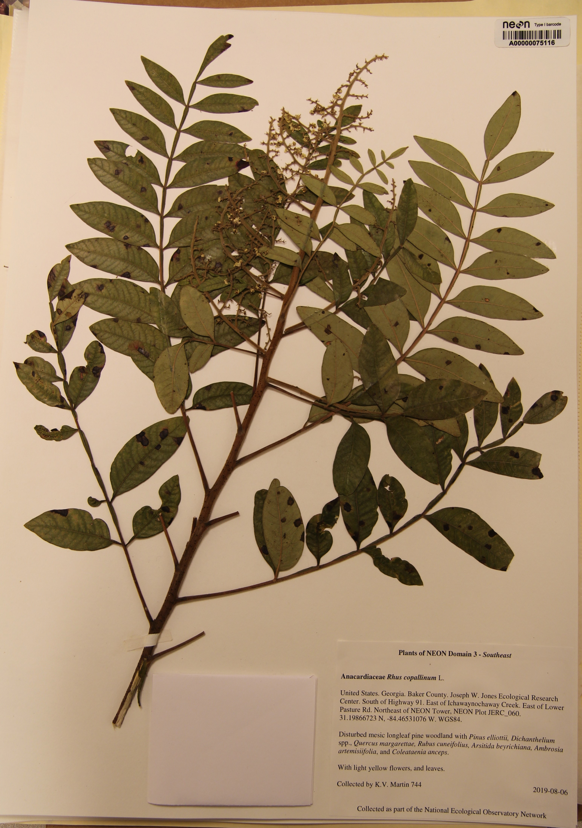
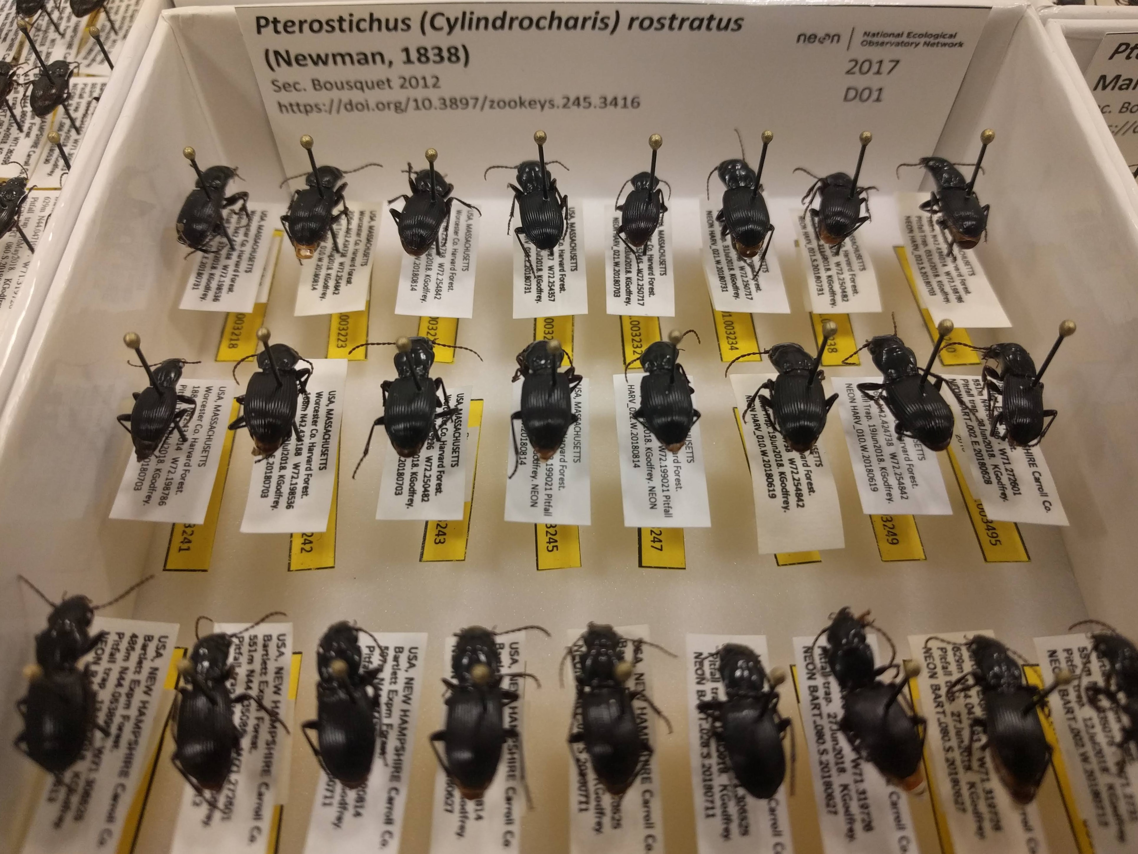
Annual sample intake
environmental
microbial
plant & algal
invertebrate
vertebrate

Slide 14
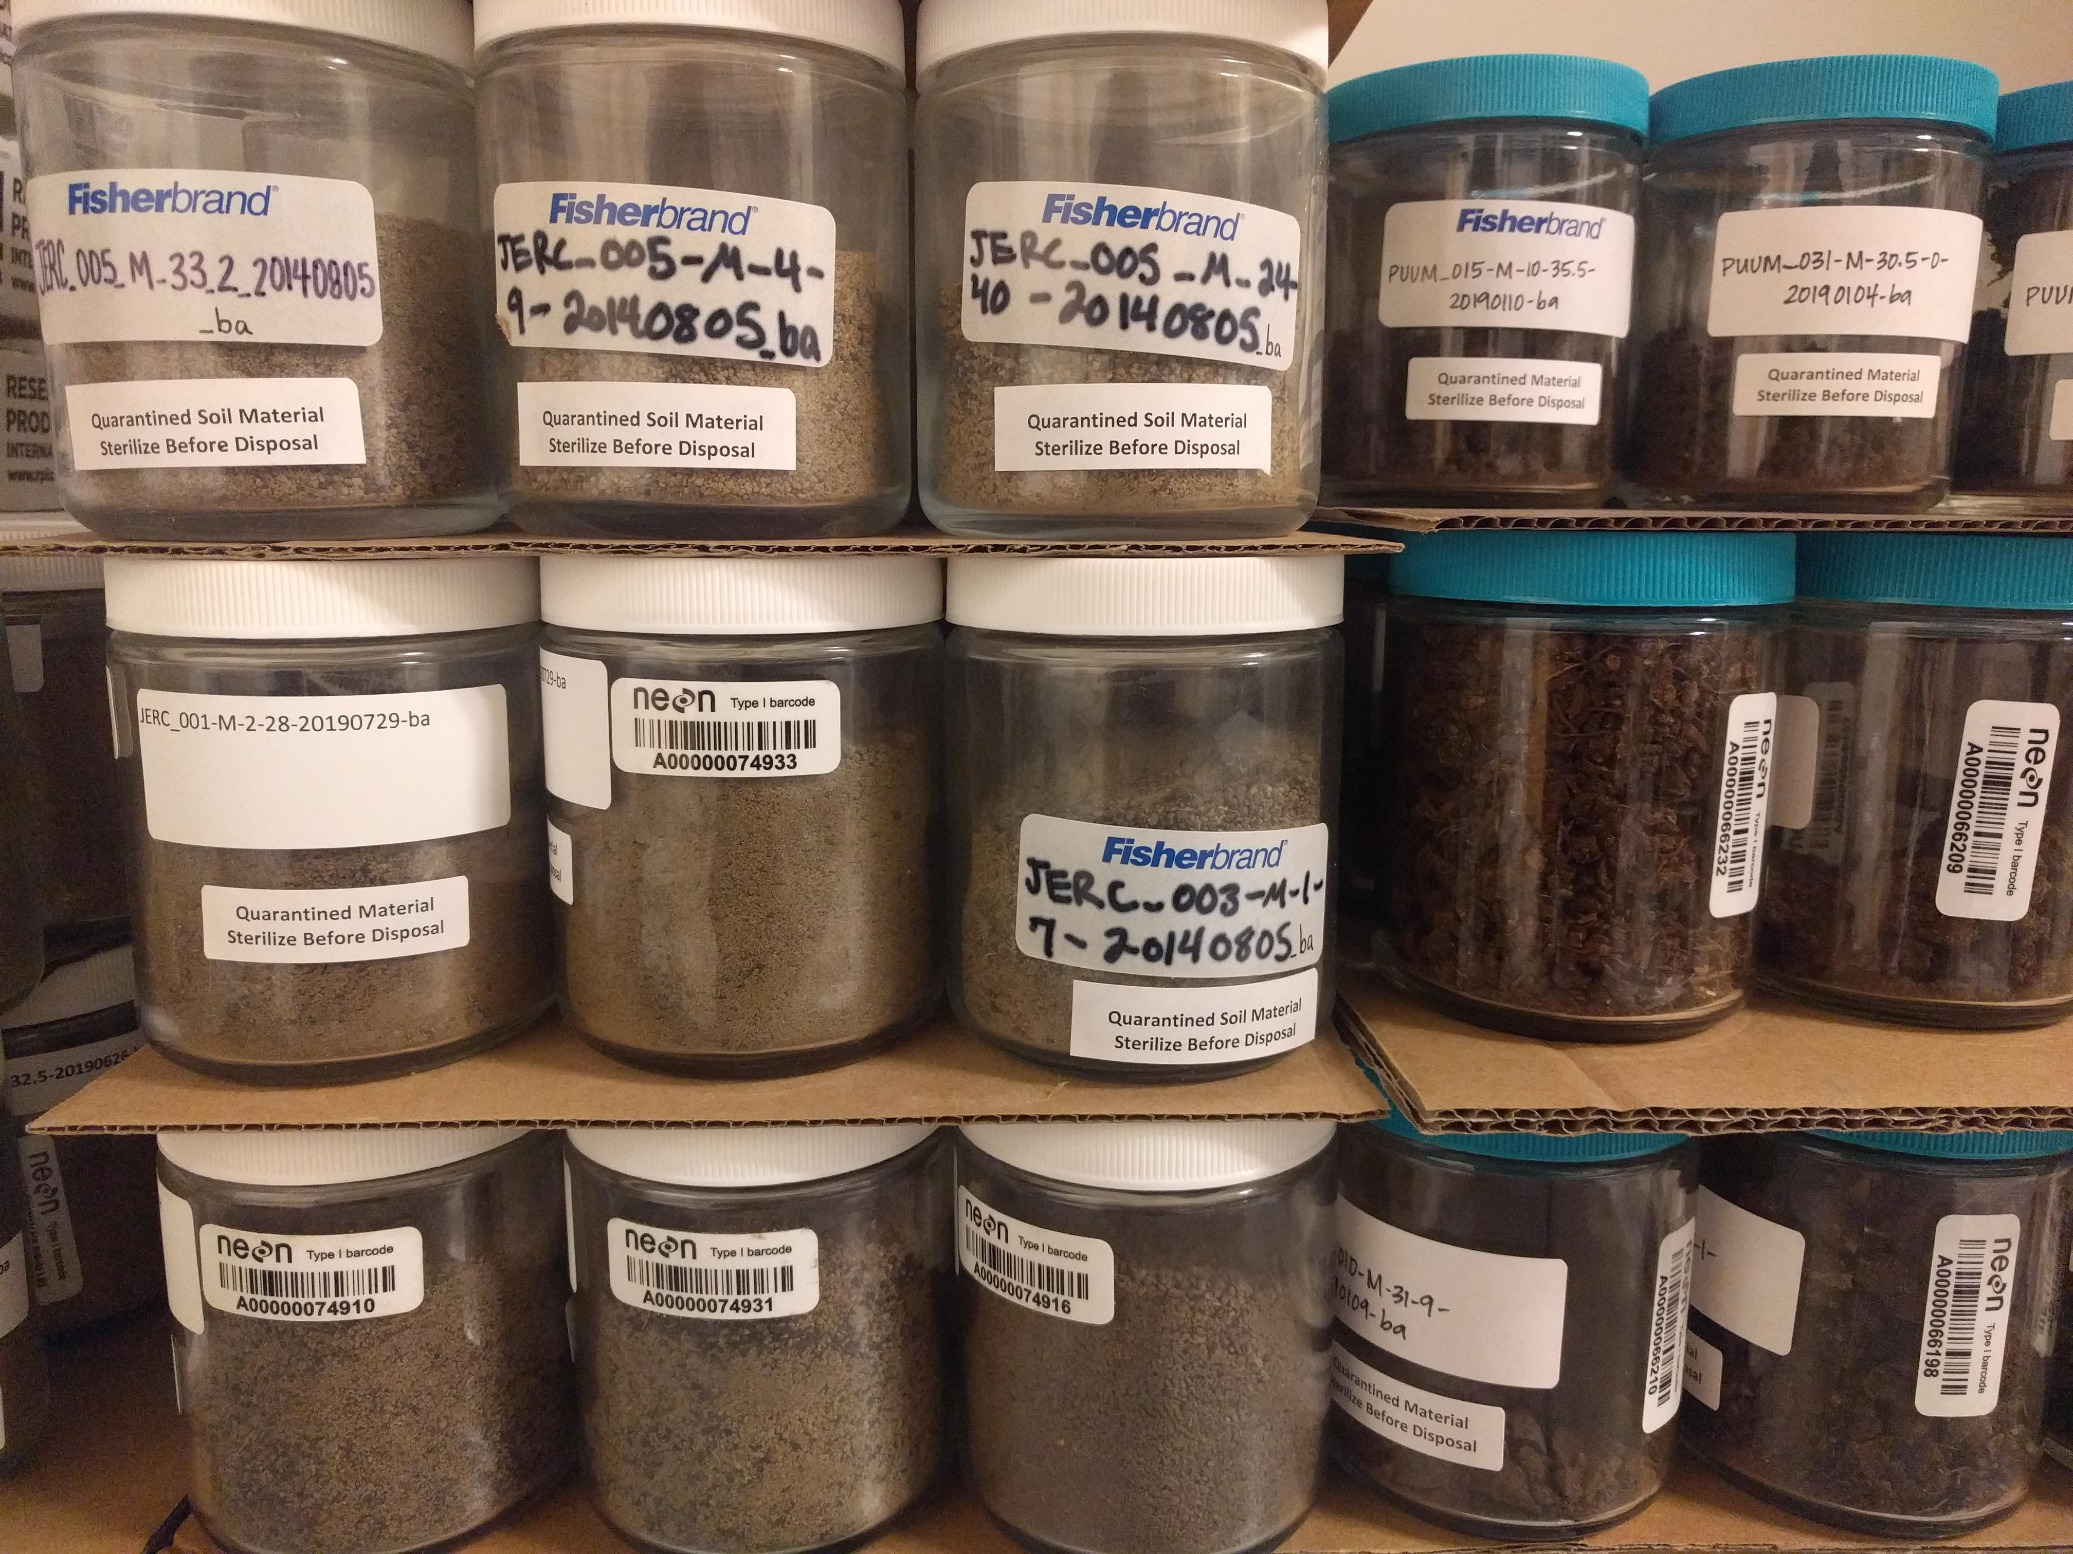
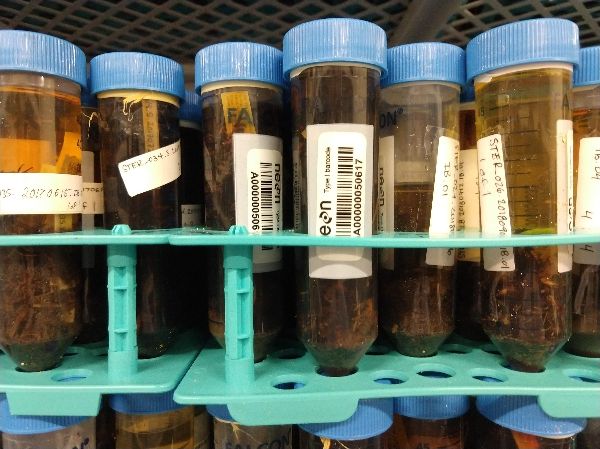
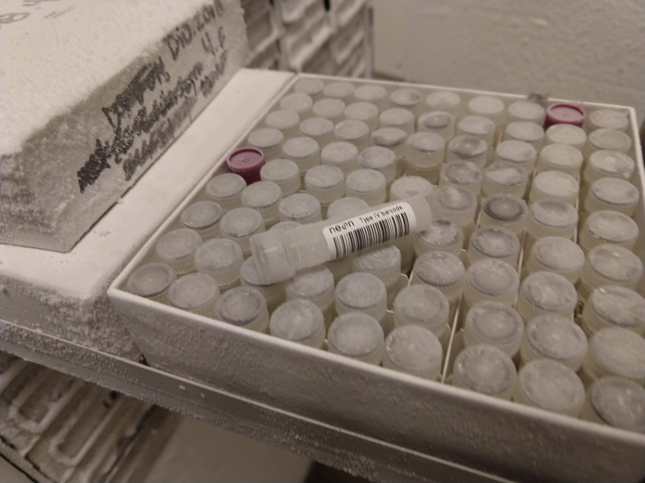
Annual sample intake
environmental
microbial
plant & algal
invertebrate
vertebrate

Slide 15
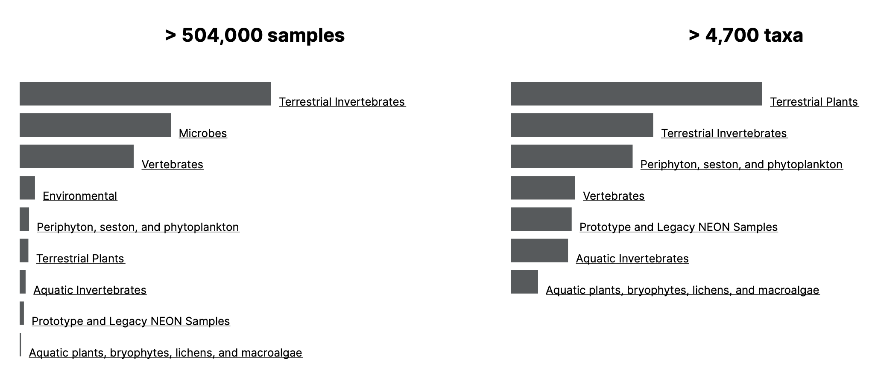
Samples are currently available for research

Slide 16
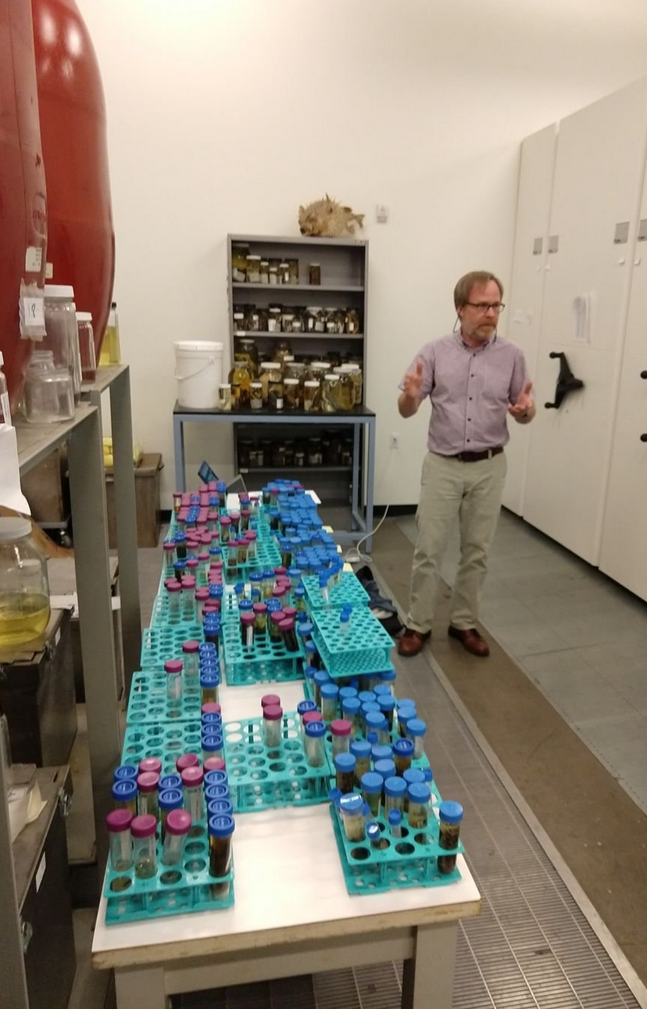
External researchers are using NEON Biorepository data and samples in research
biorepo@asu.edu

Slide 17
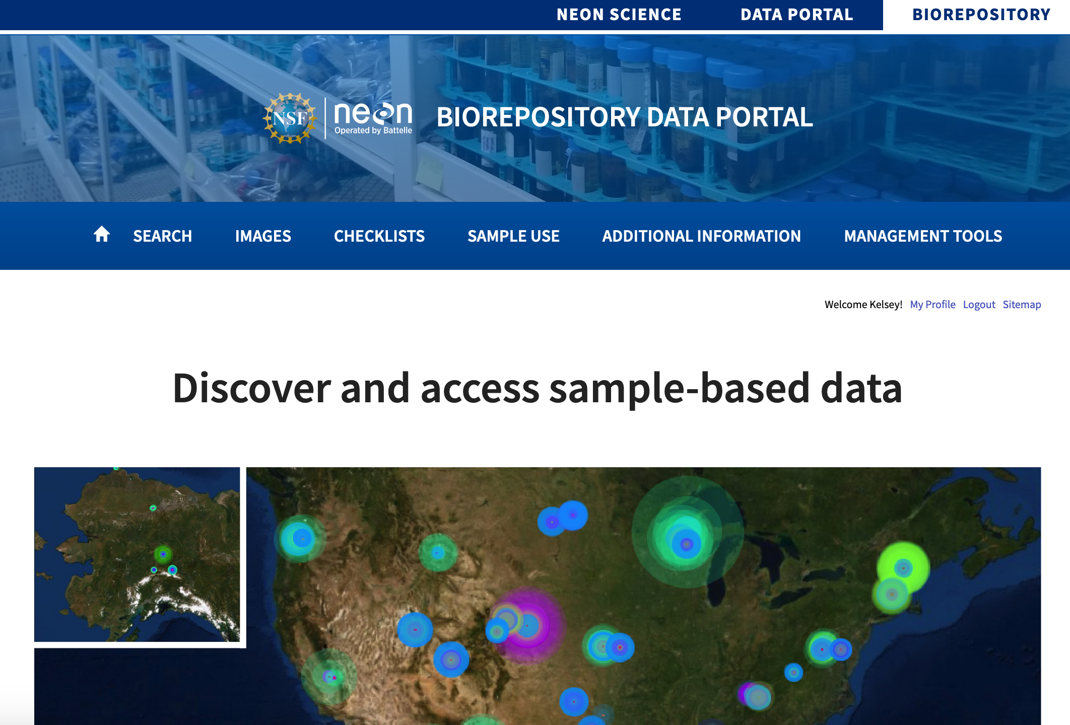
https://biorepo.neonscience.org/
Data from shipping manifests, NEON data portal, NEON API, and external researchers (PIs) → NEON Biorepository data portal

Slide 18
Biodiversity Occurrence Records

Slide 19
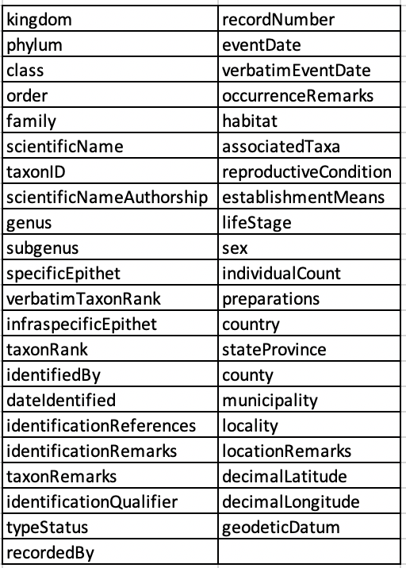
Sample data follow the Darwin Core Standard developed by Biodiversity Information Standards (TDWG):
stable, straightforward and flexible framework for compiling biodiversity data from varied and variable sources
biorepo@asu.edu

Slide 20
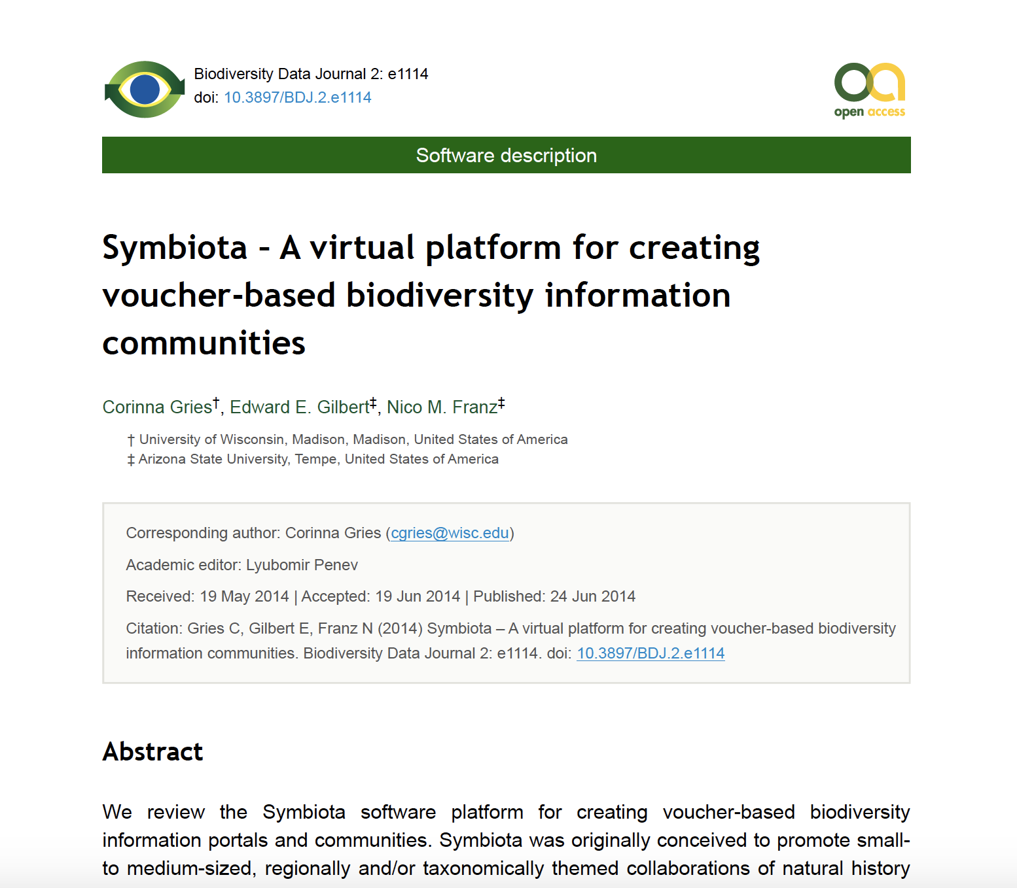
The NEON Biorepository data portal is a Symbiota- based collections portal.
Most frequently used software in North America for managing Natural History Collections records
Mid-level data aggregation platform and user-driven content management system → users can view and contribute directly to sample data and publish in this portal

Slide 21
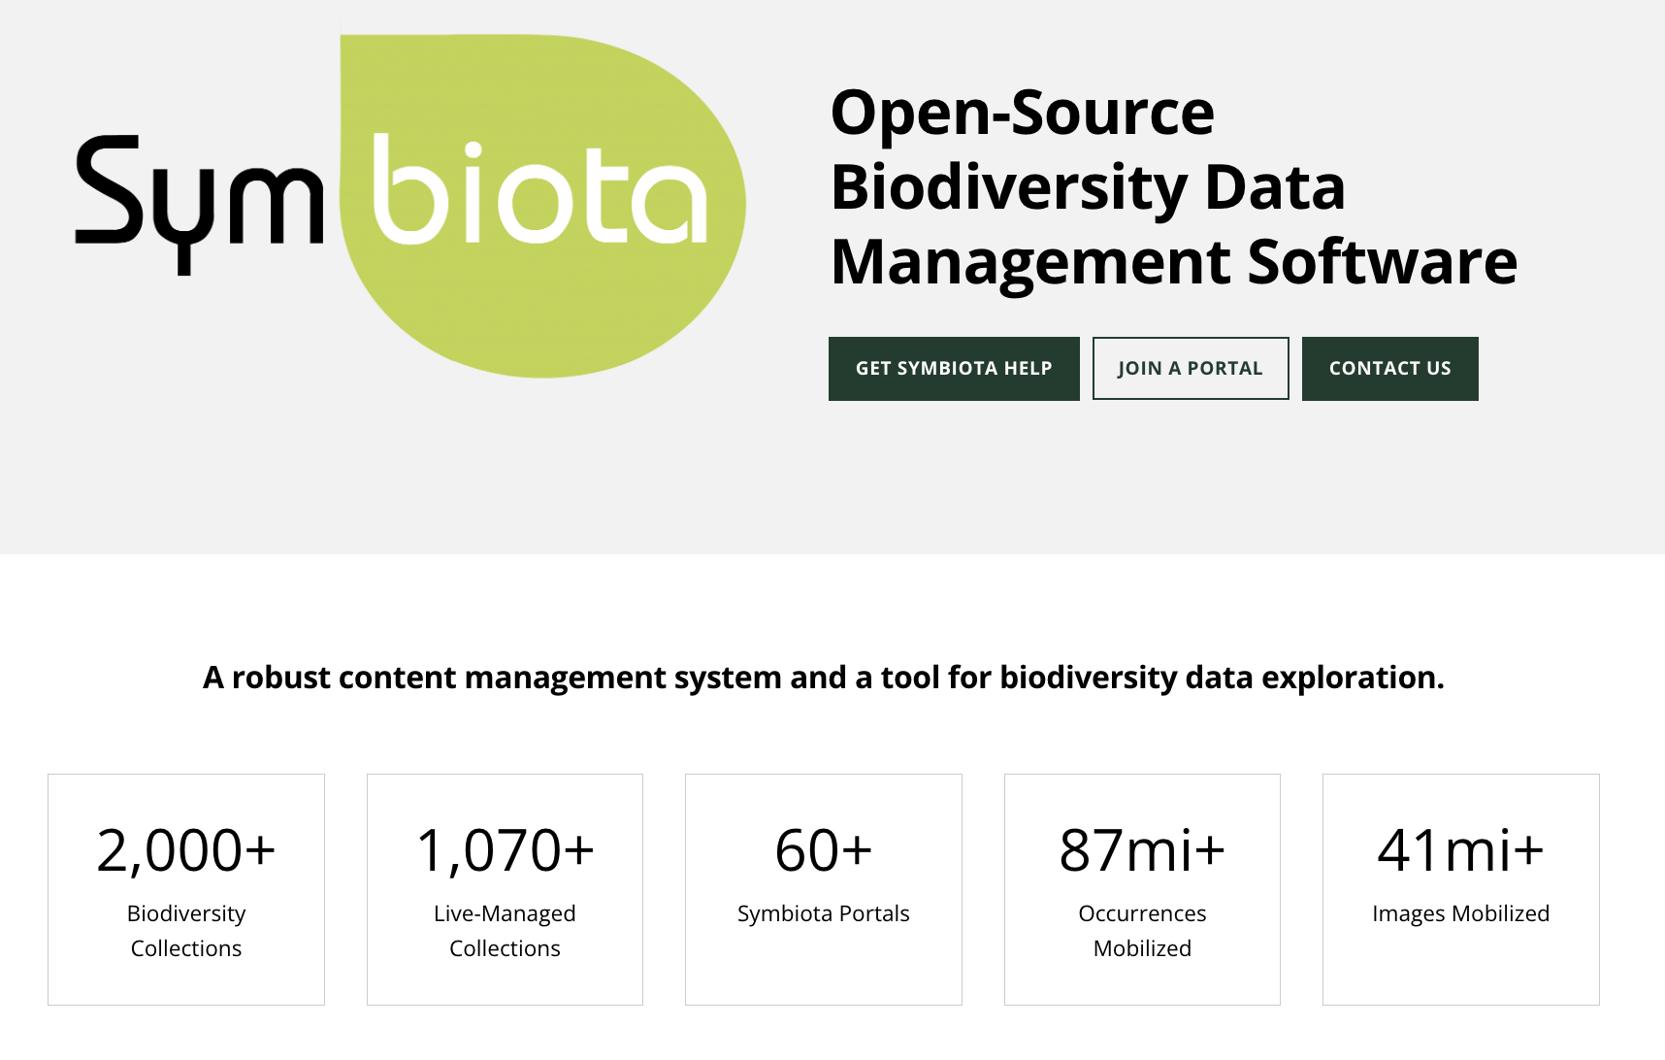
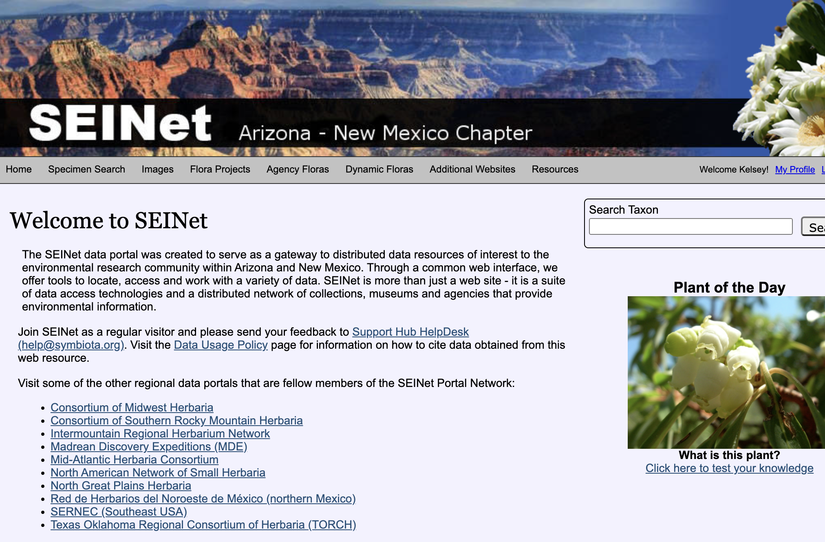
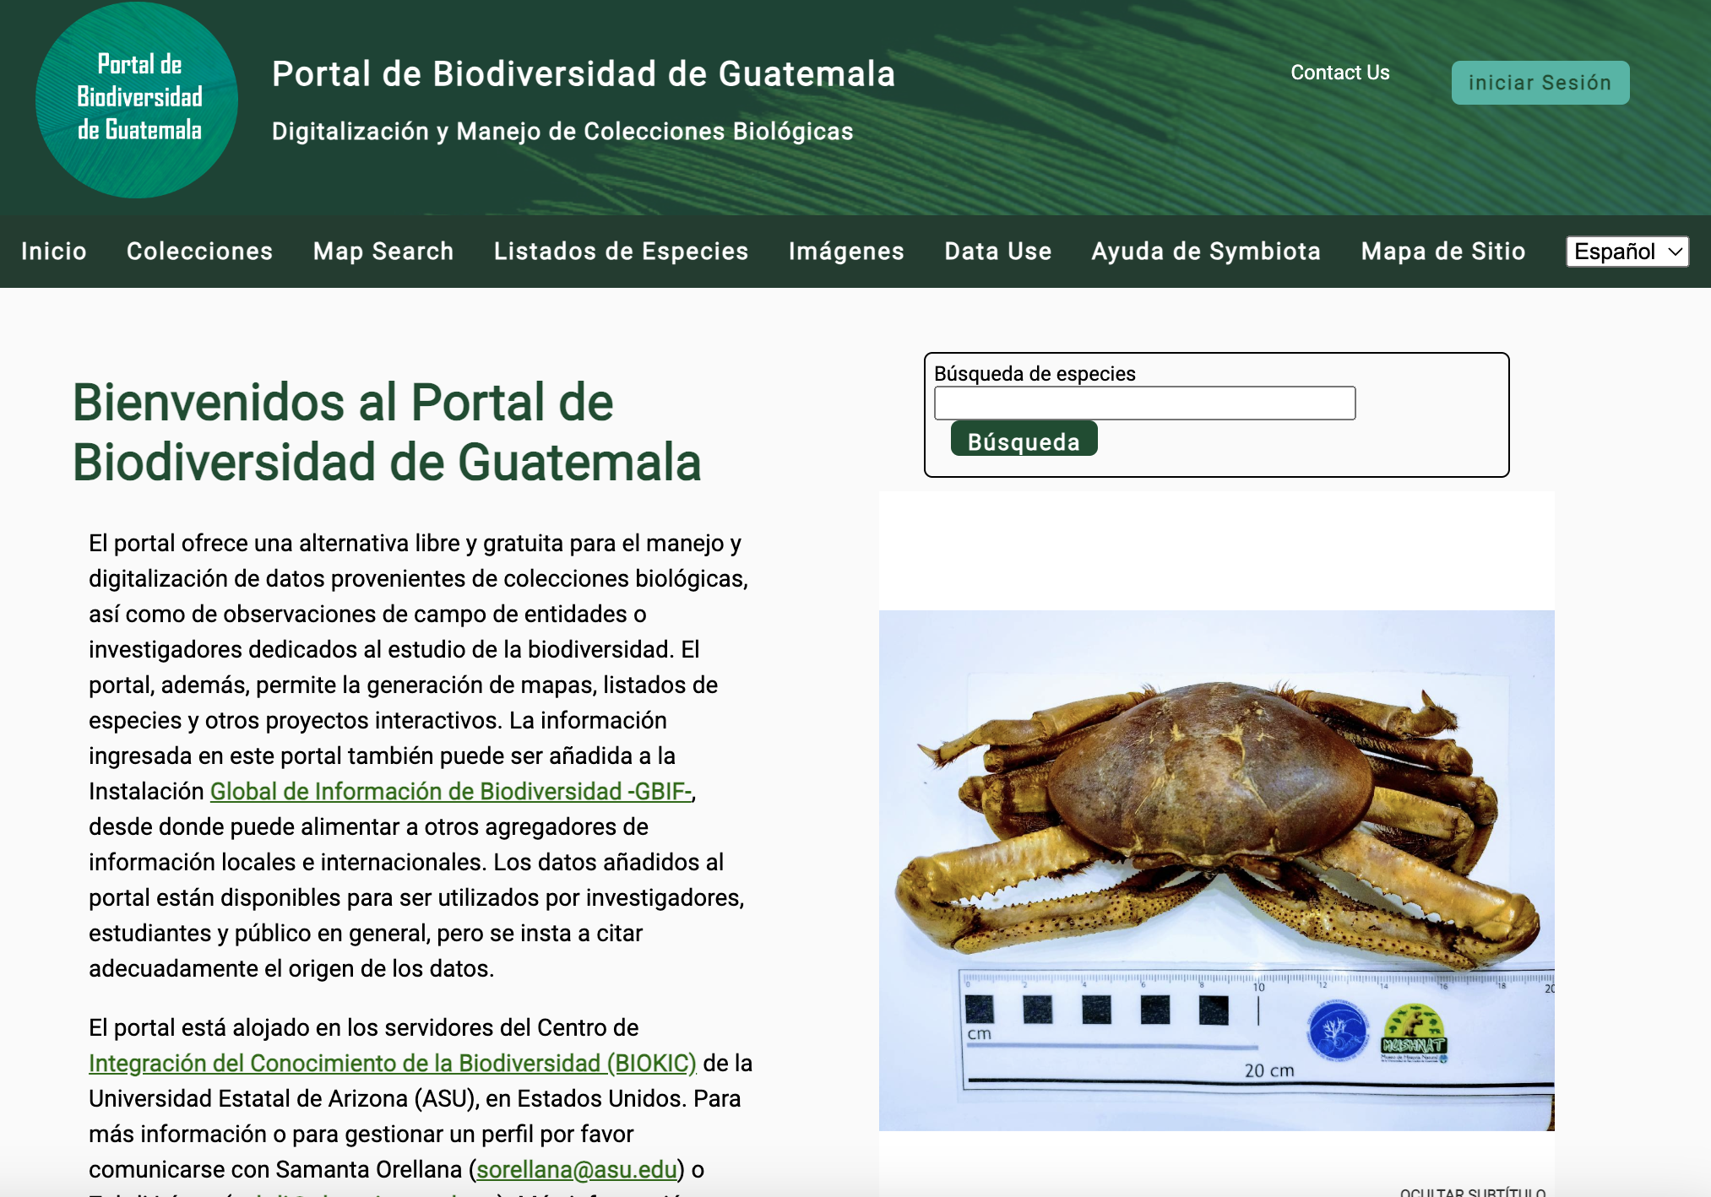
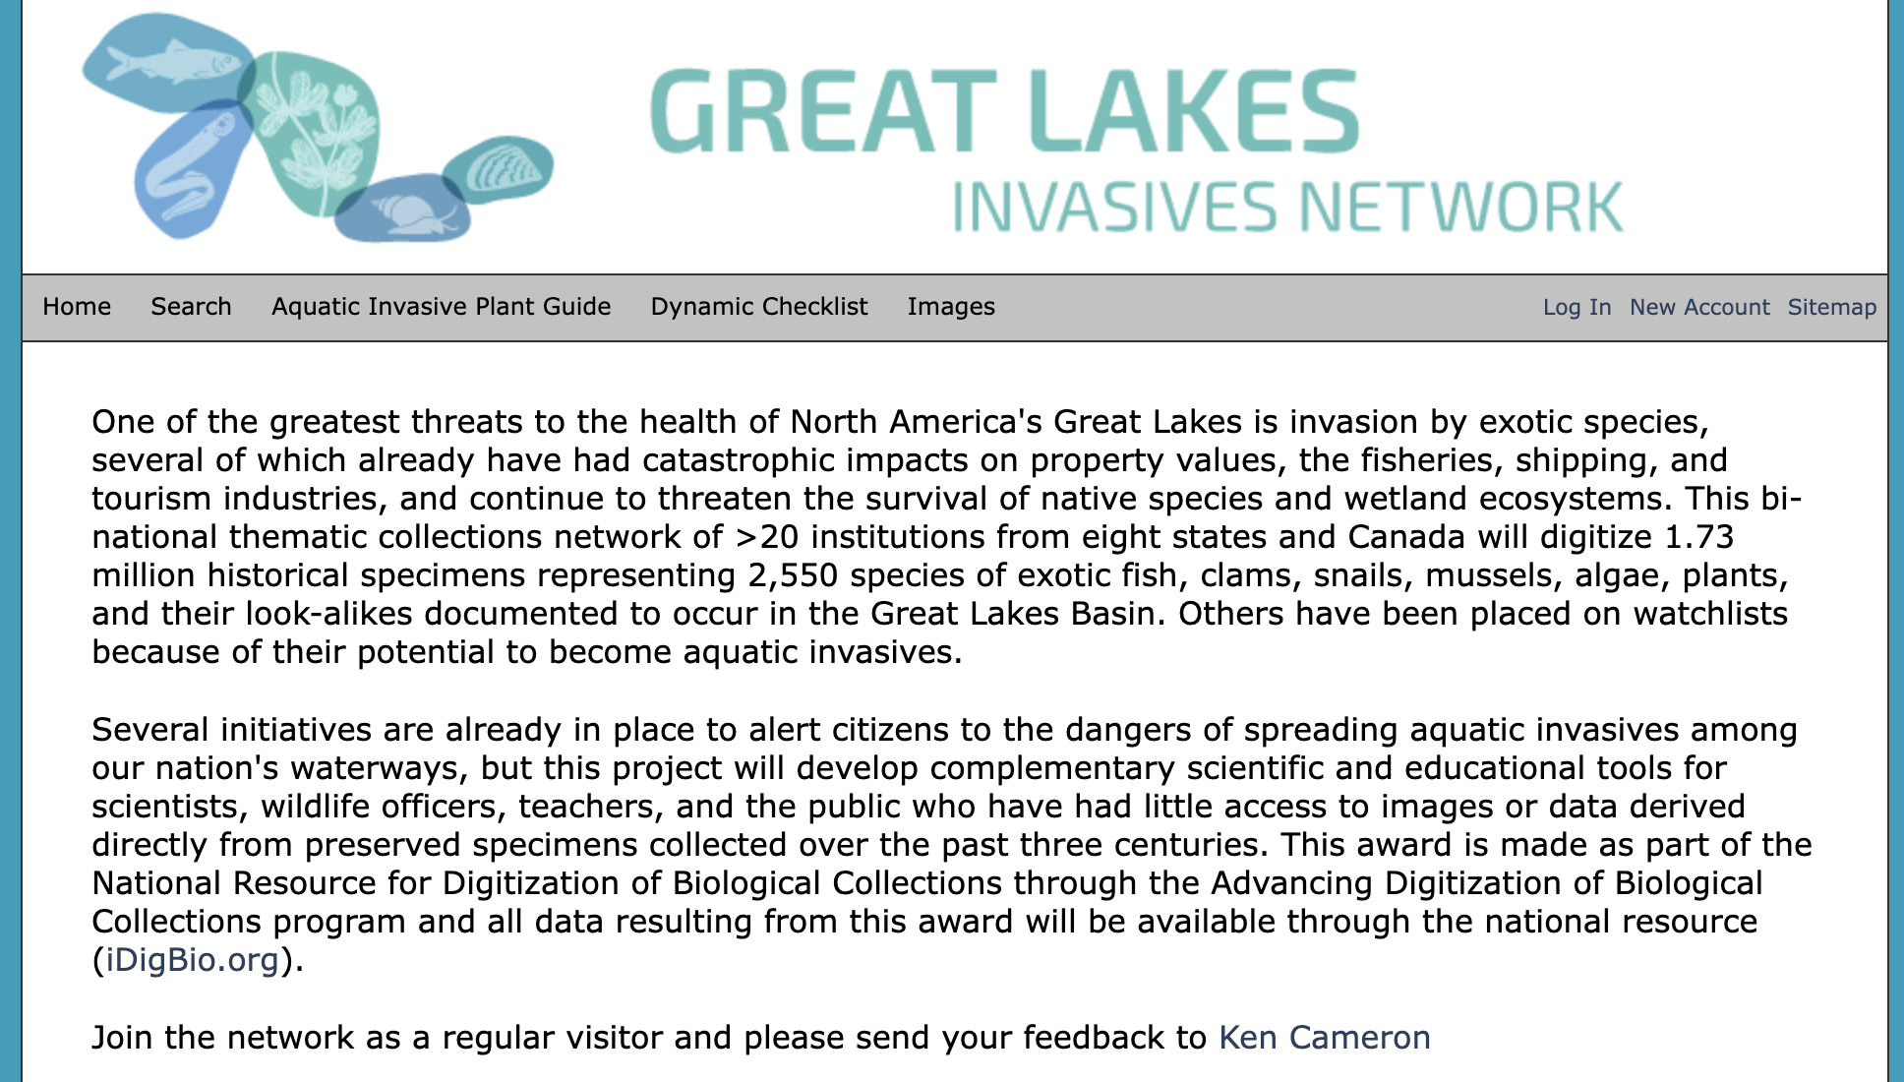

Slide 22
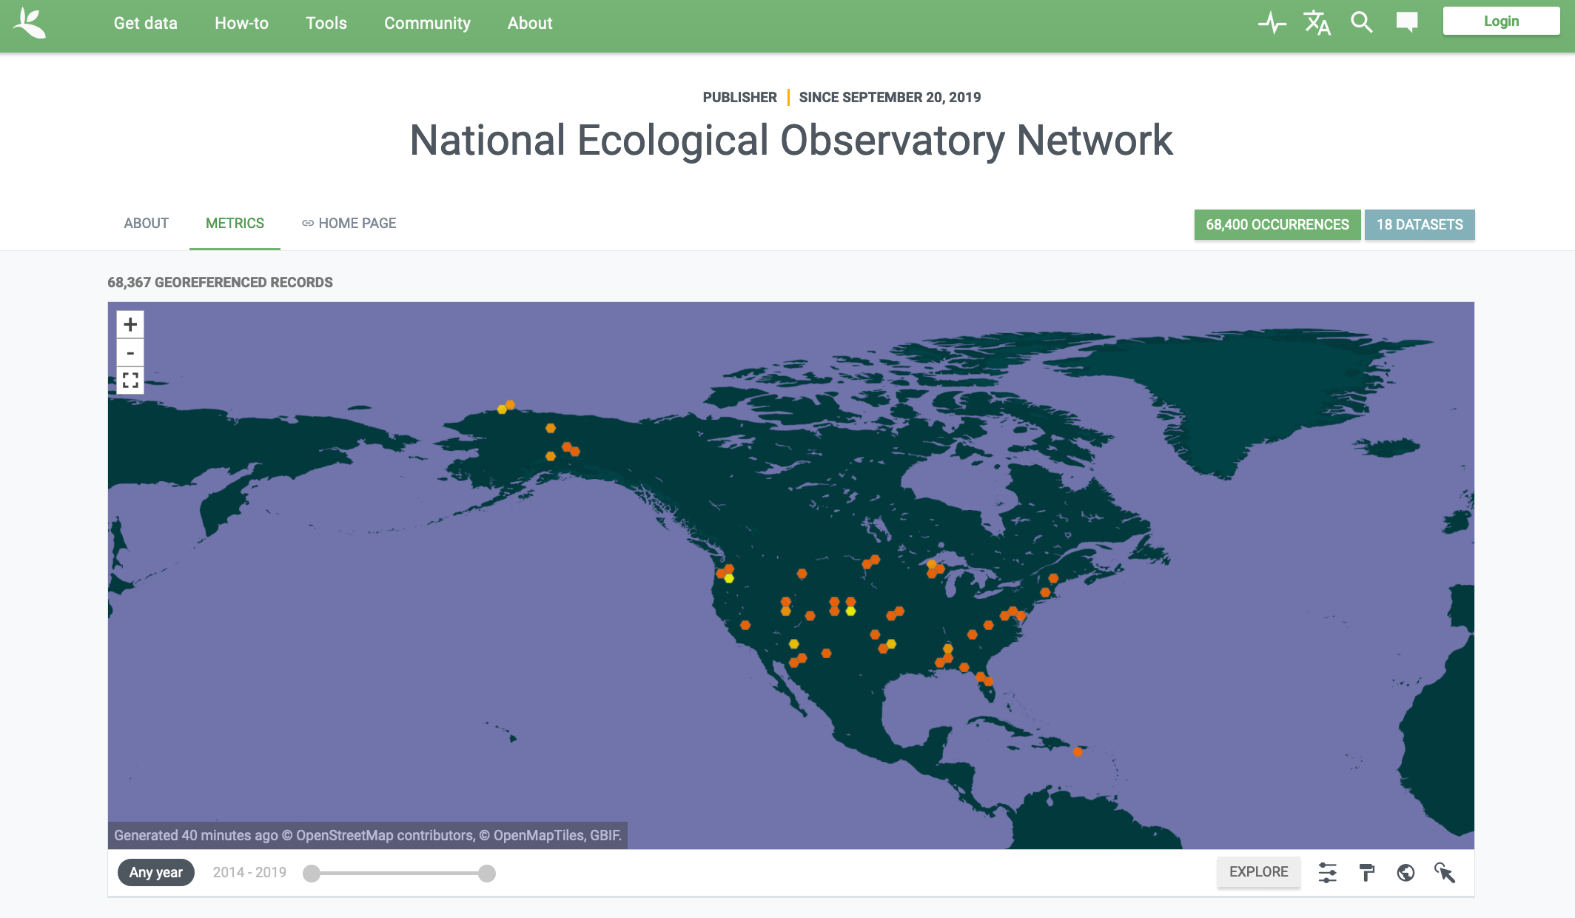

NEON Biorepository data visibility and discoverability is greatly increased by publishing to data aggregators
51 datasets
>1 million observations
>460 citations

Slide 23



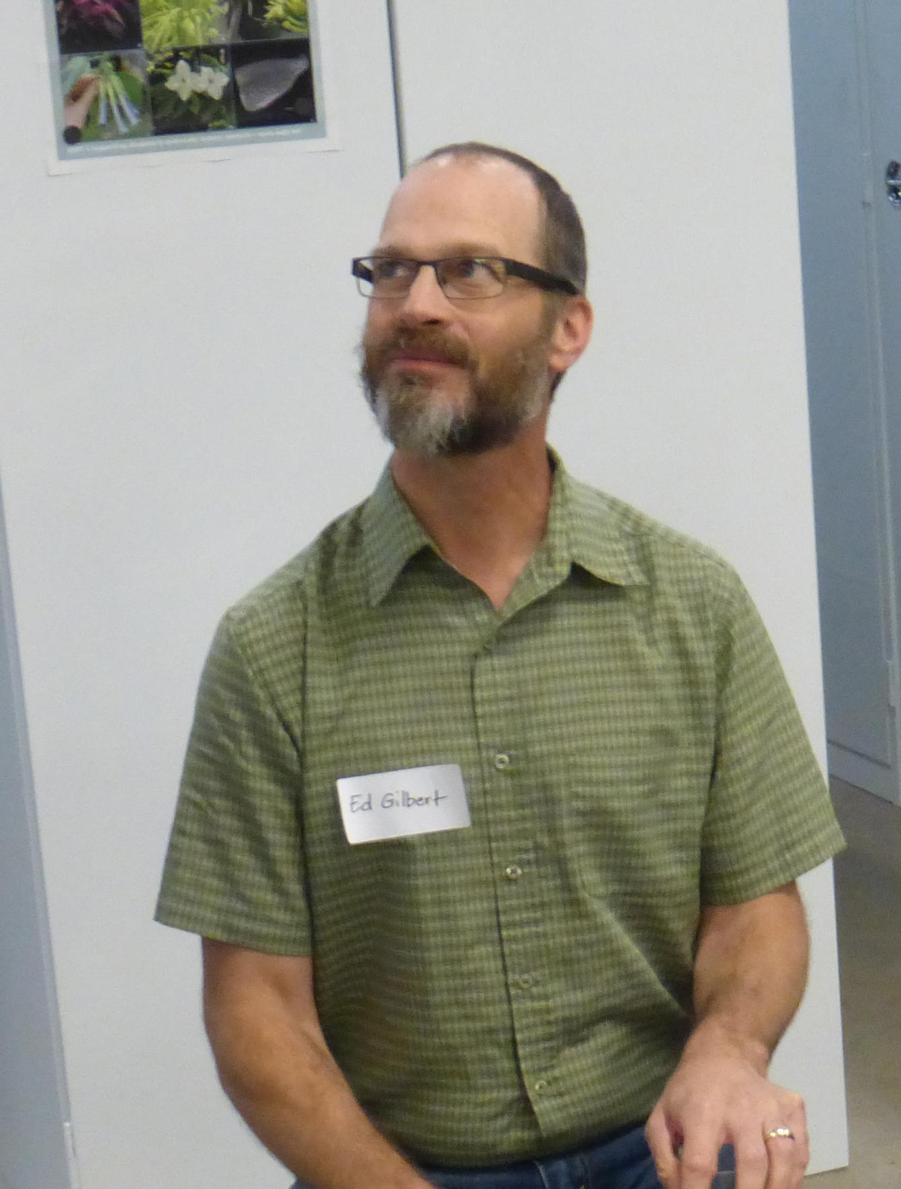

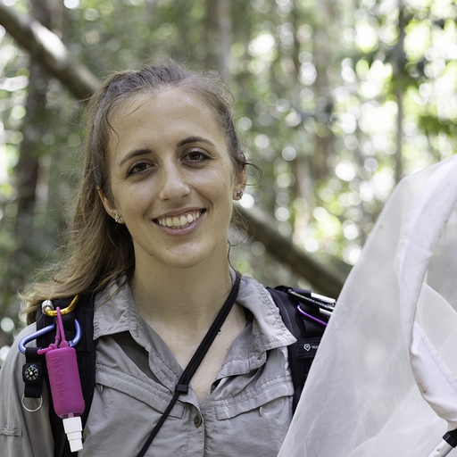
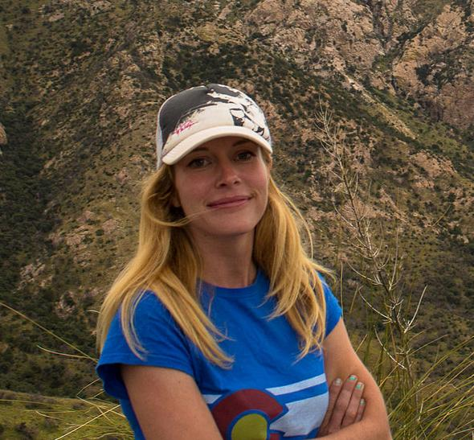
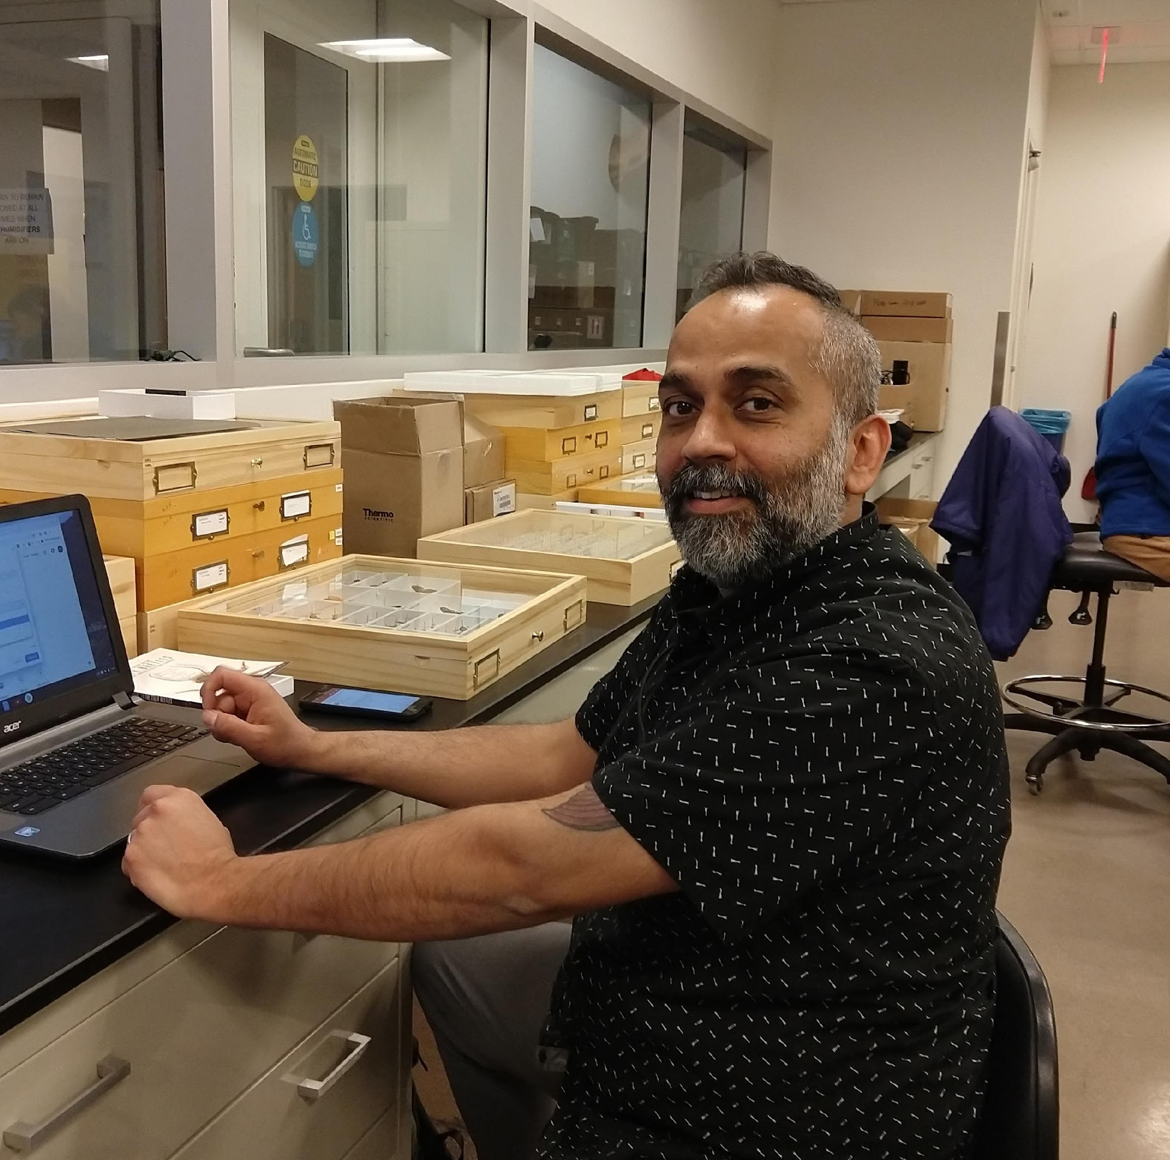

biorepo@asu.edu
Dr. Chandra Earl
Biodiversity Informatician
Dr. Nico Franz
Operational Lead
Dr. Kelsey Yule
Data Science Specialist
Ed Gilbert
Lead Symbiota Developer
Laura Steger
Environmental & Zoological Collections Manager
Isa Betancourt
Invertebrate Collections
Manager
Azhar Husain
Cryo Collections Manager

Slide 24
The NEON Biorepository Portal: Finding and downloading sample data

Slide 25
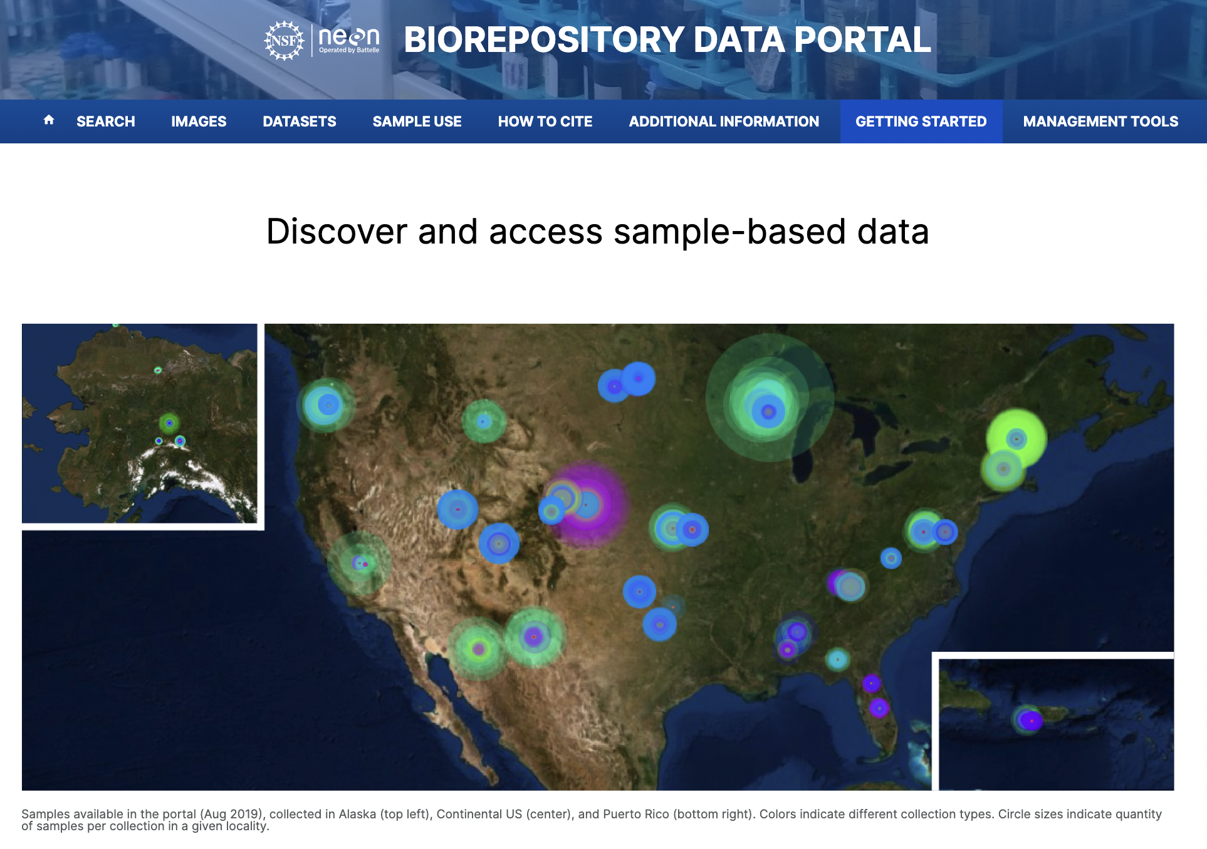
https://biorepo.neonscience.org/portal/

Slide 26
Find the following in the NEON Biorepository data portal
A description of NEON soil microbe sampling protocols and links to related NEON data products
All Peromyscus leucopus voucher specimens
What taxa come up in the results?
Where is the determination history for these individuals? How have the determinations been made?
What material is available from these specimens?
A list of specimens used in a recent publication concerning mosquito phylogenomics
The number of unique taxa within the Carabidae family collected at…
The SRER site
All NEON sites in the western continental US

Slide 27
Tutorial: Build a sample list to answer a research question
Develop a research question
Download NEON data of interest using the neonUtilities R package
Narrow the research scope based on available NEON data
Download potentially relevant samples via the NEON Biorepository data portal
Manipulate data to find a list of most appropriate samples
Simple visualization of the samples
https://github.com/kyule/neon-biorepo-tutorial/
Not necessary to clone the entire repo!
Only need to download neon-biorepository-tutorial.Rmd
or html

Slide 28

biorepo@asu.edu | www.biorepo.neonscience.org

